Slide 1
Computer Numerical control – what is it ?
Control achieved by the use of
Numbers, symbols, signals, Letters, Codes, Words, instructions
In short, a Language-based communication with machines to be controlled
Inputs to the machine → through numbers, letters and codes
The processing of data → through numerical calculations and logic operations
The execution of operations → through generated signals

Slide 2
Numerical control, computer numerical control
In the beginning – only numbers and alphabets were used to achieve control, together with hard-wired circuitry – there was no computer - so it was just numerical control
Later, with the advent of computers, a computer was used in the process of control – so it became computer numerical control or simply computer control

Slide 3
Area of application of computer control
Is CNC primarily meant for mass (high volume) production ?
Fixed automation → SPM (Special purpose machines) with automated material handling devices are employed in such cases. This helps in reducing machining time, cyclic idle time and non-cyclic time losses.
Why not CNC ? – In mass production, there is hardly any change in part design over extended periods of time. Hence, CNC, which possesses flexibility –is not necessary in mass production.
Why not Fixed automation for low volume production ? In low volume production, part design changes frequently. Fixed automation is not amenable to frequent changes.
But if control is achieved by application of letters, numbers, codes and language, it is easy to change – and that is CNC
Hence – flexibility is the one advantage which makes computer control more suitable than fixed automation in case of low volume production.
In addition, CNC has the ability to manufacture complex shapes without the use of part-specific tooling.

Slide 4

How is computer control achieved ?
Motor
Speed gear box
1:1
Carriage
Feed Gear Box
Nut
By interfacing the machine with a computer
By modifying conventional machine tool architecture
By adding devices which permit the control of motion and other actions from computer
By writing and executing a program from the computer

Slide 5
What is a CNC program ?
A CNC program is a sequence of commands, written in a suitable language, meant for controlling the operations of a machine
When executed, it makes a machine tool carry out some motions and auxiliary operations
As a result, a part is successfully produced from a blank
There are other operations also, apart from machining, which are successfully controlled by CNC program execution.

Slide 6
Example of typical command blocks
N006 G90 G00 X20 Y30
N007 Y50
N008 G01 X100 Y100 F200
N009 G02 X140 R30
N010 M30
Y
(20,50)
(100,100)
(140,100)
r30
(20,30)
X

Slide 7
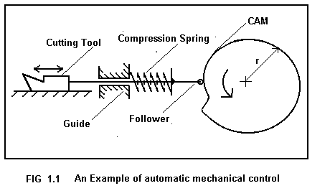
In mechanical automation
Motion is controlled by physical devices, like Cams, jigs, templates, tracers, limit switches, guides, operators etc
Question – In order to get constant forward feedrate of the cutting tool, what should be the profile of the CAM, which is undergoing uniform circular motion ?

Slide 8
Computer controlled machines
CNC is capable of controlling a machine through
Programmed instructions → Digital signals → rotation of motors → leading to
Achieving a programed extent of motion
Achieving a programmed ratio of axes velocities
Programmed a programmed feed velocity along cutter path

Slide 9
Digital signals, Binary logic and logic gates
Digital circuitry is employed in almost all aspects of CNC control. Example : Data input, data storage, data processing, interpolation, motion execution, feedback etc.
AND
a
c
b
a
OR
c
b

Slide 10
Architecture of the control unit
MCU = DPU + CLU
MCU = Machine control unit
DPU = Data processing unit – contains data entry, data processing, interpolator
CLU = Control loops unit – contains all devices for achieving required motion along an axis (example : The motor, the lead screw-nut, the gear box, the feedback device etc)

Slide 11
What are the modifications of the conventional machine tool
More robust and rigid for the same power level
Backlash elimination, incorporation of recirculating ball screw-nut mechanism
Gear box elimination – gear boxes limit the ratio of axes speeds
Feedback where necessary
Simple kinematic chains / structures instead of complex or compound chains / structures
Motors with lower time constant (faster response)
Interpolator where necessary
Control over displacement, velocity, acceleration of the axes in order to avoid overshoots, sluggish response and resulting inaccuracies in part geometry

Slide 12
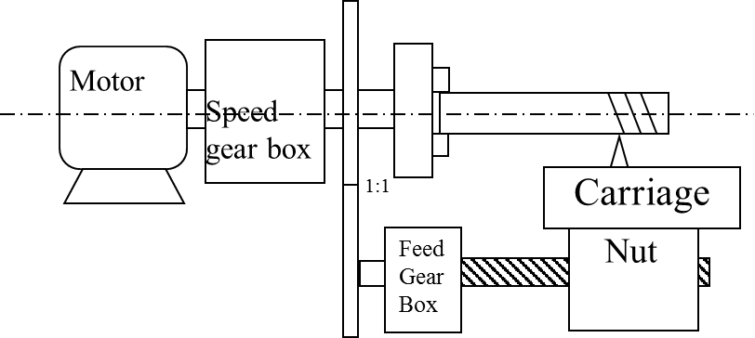
Is it possible to implement computer control on this machine tool ?

Slide 13
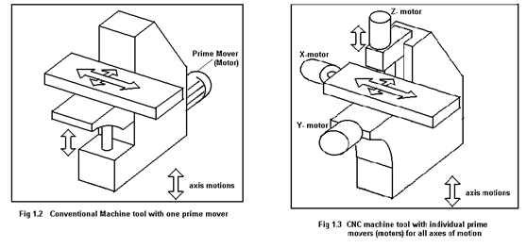
Simple kinematic chains for CNC machine tools

Slide 14
Advantages
Flexibility
It is possible to incorporate automation in low level production
Ability to cut complex profiles
Higher productivity and Accuracy in many applications
Initial investment is high
Required skill level of machinist, operator etc is high
Disadvantages

Slide 15
Practice MCQ questions
Main advantage of CNC machining over Fixed automation is
Flexibility b. Accuracy
c. Speed d. None of the others

Slide 16
Signals / variables which can take up only 2 values – Binary variables
Power supply
A = 0 volts
t, seconds
A = 5 volts
Power supply
t, seconds
A = Pulsed 5/0 volts
Power supply
t, seconds

Slide 17
Truth tables for some logic operations
A | B | A/ | B/ | A + B | A.B | A⊕ B | A#B
1 | 1 | 0 | 0 | 1 | 1 | 0 | 0
1 | 0 | 0 | 1 | 1 | 0 | 1 | 1
0 | 1 | 1 | 0 | 1 | 0 | 1 | 1
0 | 0 | 1 | 1 | 0 | 0 | 0 | 1

Slide 18
Binary logic operations
law of complements
a + a/ = 1
a . a/ = 0
a + 1 = 1
a . 0 = 0
a . 1 = a
a + 0 = a
Also
a+a = a
a.a = a
• Commutative law
a + b = b + a
a.b = b.a
• Distributive law
a.(b + c) = a.b + a.c
• associative law
a + b.c = (a + b) . (a + c)
• De Morgan’s laws
(a + b)/ = a/ . b/
(a . b)/ = a/ + b/

Slide 19
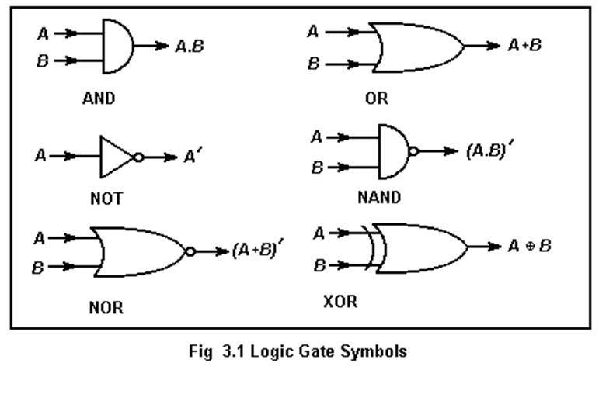
Symbols for logic gates

Slide 20
Addition of two bits
Decimal Binary
1 + 1 = 2 1 + 1 = 10
1 + 0 = 1 1 + 0 = 1
0 + 1 = 1 0 + 1 = 1
0 + 0 = 0 0 + 0 = 0
A | B | Carry | Sum
1 | 1 | 1 | 0
1 | 0 | 0 | 1
0 | 1 | 0 | 1
0 | 0 | 0 | 0
A | B | A/ | B/ | A + B | A.B | A⊕ B
1 | 1 | 0 | 0 | 1 | 1 | 0
1 | 0 | 0 | 1 | 1 | 0 | 1
0 | 1 | 1 | 0 | 1 | 0 | 1
0 | 0 | 1 | 1 | 0 | 0 | 0

Slide 21
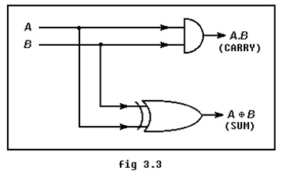
A half adder – can add up two bits

Slide 22
Addition of 2 bytes
Carry 1011111
11011011
+ 11001111
110101010
You might well have to add 3 bits together

Slide 23
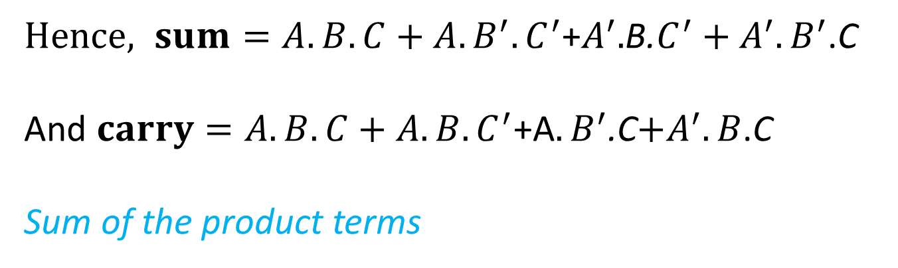
Addition of 3 bits
a | b | c | carry | sum
1 | 1 | 1 | 1 | 1
1 | 1 | 0 | 1 | 0
1 | 0 | 1 | 1 | 0
1 | 0 | 0 | 0 | 1
0 | 1 | 1 | 1 | 0
0 | 1 | 0 | 0 | 1
0 | 0 | 1 | 0 | 1
0 | 0 | 0 | 0 | 0
The sum takes up a value of 1 if
A and B and C are all 1
Or A is 1 and B is 0 and C is 0
Or A is 0 and B is 1 and C is 0
Or A is 0 and B is 0 and C is 1
$Hence, sum=A.B.C+A.B^{′}.C^{′}$+$A^{′}.$B.$C^{′}+A^{′}.B^{′}$.C
And$carry=A.B.C+A.B.C^{′}$+A$.B^{′}$.C$+A^{′}.B$.C
Sum of the product terms

Slide 24
The value of carry
Carry = A.B.C + A.B.C/ + A/.B.C + A.B/.C
= A.B.C + A.B.C/ + A.B.C + A/.B.C + A.B.C + A.B/.C
= A.B.(C+C/) + B.C.(A+A/) + A.C.(B+B/)
= A.B + B.C + A.C

Slide 25
The value of Sum
Sum = A.B.C + A.B/.C/ + A/.B.C/ + A/.B/.C = A . (B.C + B/.C/) + A/. (B.C/ + B/.C)
Now, B.C/ + B/.C = B ⊕ C , and
(B.C + B/.C/)/ = (B.C) / . (B/.C/)/ = ( B/ + C/ ) . ( B + C ) = B.B/ + B.C/ + B/.C + C.C/
= B.C/ + B/.C = (B ⊕ C) /
Hence,
A . (B.C + B/.C/) + A/. (B.C/ + B/.C) = A.(B ⊕ C)/ + A/ . (B ⊕ C) = A ⊕ B ⊕ C

Slide 26
Numerical problem 2.1
There is a grinding machine in which coolant is to be applied automatically if
The temperature ≥ 60° C , surface speed ≥ 20 m/s & table feed ≤ 15 m/min
The temperature ≥ 60° C , surface speed < 20 m/s & table feed > 15 m/min
The temperature ≥ 60° C , surface speed ≥ 20 m/s & table feed > 15 m/min
If sensors are set up in such a way that the following variables
A = 0 when temperature < 60° C
= 1 when temperature ≥ 60° C
B = 0 when surface speed < 20 m/s
= 1 when surface speed ≥ 20 m/s
C = 0 when feed ≤ 15 m/min
= 1 when feed > 15 m/min
Make a circuit which would send an output signal S = 1 when coolant is supposed to be applied, otherwise 0.
Grinding machine
Coolant
A
?
B
S=1/0
C

Slide 27
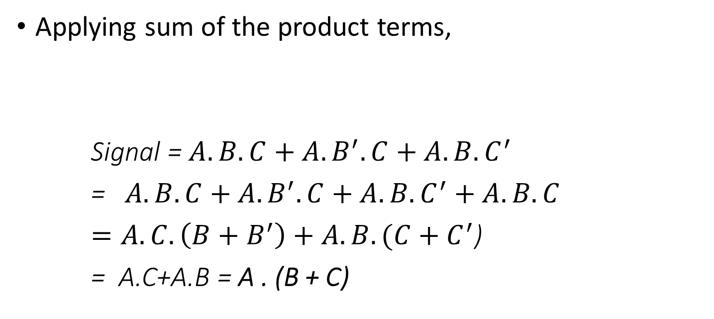
Solution to Prob 2.1
A | B | C | signal
1 | 1 | 1 | 1
1 | 1 | 0 | 1
1 | 0 | 1 | 1
1 | 0 | 0 | 0
0 | 1 | 1 | 1
0 | 1 | 0 | 0
0 | 0 | 1 | 0
0 | 0 | 0 | 0
Applying sum of the product terms,
Signal = $A.B.C+A.B^{′}.C+A.B.C^{′}$
=$A.B.C+A.B^{′}.C+A.B.C^{′}+A.B.C$
$=A.C.\left(B+B^{′}\right)+A.B.(C+C^{′}$)
= A.C+A.B = A . (B + C)

Slide 28
The Spread of CNC technology
CNC machine tools find wide application in low level and medium level production.
CNC technology supports the realization of unconventional concepts in manufacturing – like Rapid Prototyping (RP)
It is possible to manufacture complex shapes by CNC

Slide 29
Types of Classification
Type of cutter movement (or motion control)
Point - to – point (P-T-P) and Continuous
Type of control - Open loop and Closed loop
Type of 'organization of machine operations' - Machine tool, machining centre and turning centre
Type and number of axis movements

Slide 30
PTP – Point-to-point control
The tool or cutter has to move from one point to another, the path of the cutter between these points is not critical
Examples
Drilling, EDM die sinking, spot welding, brazing, soldering
Salient features
The control system does NOT require an interpolator
The cutter moves from one point to another and carries out machining / required operation at these points.
It generally covers the distances between the points at highest attainable velocity.
Cutter radius compensation is generally not required

Slide 31
How do the PTP machines operate
There is (generally) no control of axial speeds. The axes may move at highest possible speeds
There is no cutting action while the tool is moving from one position to another.

Slide 32
Continuous control – straight cut
The cutter moves along straight lines at controlled rates between points
As the cutter moves, it removes material by cutting
Linear interpolation is carried out
Circular interpolation is not done

Slide 33
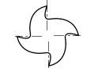
Continuous control with both linear and circular cuts
PART
Continuous control is required in CNC machine tools where a definite profile (2-D or 3-D) is being machined. In conventional automation, physical devices are used to force the cutter to carry out motion along the profile. In CNC, physical devices are absent. Part-specific tooling is not resorted to. Program execution makes the tool follow the required path.

Slide 34
Continuous control
The path and final destination of the tool or cutter needs to be controlled.
Examples : Lathe work, Milling
Point to note – the DPU (Data processing unit has a device called an interpolator)
The cutter velocity as well as the extent of motion (destination) are controlled.

Slide 35
Point-to-point control – one example
Pulse Generator
Position down counter
1 | 1 | 0 | 1 | 0 | 1 | 1
AND
OR Gate
End of count
Lead screw 4 mm pitch, 2 start
CNC Table X →
Motor driver
Stepper Motor, 200 Steps/rev
Gear box Ratio = ¼

Slide 36
Explanations to the control loop elements
PDC = position down counter. It can be loaded with a binary number. A train of pulses input as shown will downcount the content of the counter, 1 bit for 1 pulse.
End of count = All the bits of the PDC are input t the OR gate. The OR gate will output a 0 only when all the inputs are 0. Which means – the contents of the PDC have been counted down to 0, so it is called ‘End of count’.
Pulse generator = The pulse generator sends out pulses continuously at a definite frequency

Slide 37
Explanations – cotd.
Gear Box – Normally, CNC machine tools do not employ gear boxes. However, they may be present as a fixed speed reducer for attaining a definite speed range. Gear ratio = Output RPM/Input RPM
Lead screw – nut mechanism : For 1 rotation of lead screw, the nut rotates by p × n = lead, where p = pitch and n = number of starts of screw
Stepper motor – is a motor which moves in discrete steps in response to voltage pulses as input

Slide 38
P-T-P control – another example
Decodersr
Position down counter
1 | 1 | 0 | 1 | 0 | 1 | 1
Analog voltage source
OR Gate
Decelerator
End of count
CNC Table
DC Motor
Gear box Ratio = ¼
Lead screw pitch = 4mm, 1 start
Fig. 1
Encoder, 200 holes

Slide 39
Observations on the two P-T-P systems
In both the examples – there is no velocity control of the table movements.
The position down counter is present in both as it is associated with position control.
In one case – there is internal feedback while in the other – there is external feedback.

Slide 40
MCQ on P-T-P machines
The basic length unit (BLU) of the following drive is
5 microns b. 50 microns
c. 10 microns d. None of the others
p=4 mm pitch
Table
Stepper Motor, 200 Steps/rev
Gear box Ratio = ¼

Slide 41
An example of Continuous control
Y & Z axes will have similar loops

Slide 42
Discussion on the elements of continuous control system
The PDC is present here as well, since position needs to be controlled.
The voltage pulse rate from the interpolator can be varied – so that velocity of the motor can be changed.
The up-down counter content is converted to an analog voltage which is utilized in running the motor.
There is feedback for velocity as well as position control

Slide 43
Point-to-point control – open loop
Pulse Generator
Position down counter
1 | 1 | 0 | 1 | 0 | 1 | 1
AND
OR Gate
End of count
Lead screw 4 mm pitch, 2 start
CNC Table X →
Motor driver
Stepper Motor, 200 Steps/rev
Gear box Ratio = ¼

Slide 44
When to use open loop
Open loop is employed when the prime mover can reliably move through the extent of motion programmed.
For example – the stepper motor can reliably move through discrete steps and stop exactly at a pre-defined location.
In the previous control loop shown – there is indeed a feedback loop – but it is internal

Slide 45
P-T-P control – another example
Decodersr
Position down counter
1 | 1 | 0 | 1 | 0 | 1 | 1
Analog voltage source
OR Gate
Decelerator
End of count
CNC Table
DC Motor
Gear box Ratio = ¼
Lead screw pitch = 4mm, 1 start
Fig. 1
Encoder, 200 holes

Slide 46
P-T-P closed loop
The DC motor cannot be relied upon to stop at a definite pre-defined location. Hence, an external check is necessary, together with deceleration applied towards the end of motion and mechanical brakes at the end of motion.
The typical feedback device used in this case is the encoder. The encoder, together with an LED-photoreceptor-pulse emitter circuit, is capable of sending feedback pulses which keep count of the extent of rotation of the lead screw.

Slide 47
An example of Continuous control
Y & Z axes will have similar loops

Slide 48
Closed loop - Continuous control
There are two feedback loops in this control loop
The feedback from the encoder – a train of pulses fed into an UP-DN counter. This controls position and deceleration.
The feedback from a tachogenerator. An analog voltage for control of velocity response. Time constant of the PMDC motor is reduced as a result.
There is also a third internal feedback for the PDC.
Continuous control in open loop is possible and can be realized in low duty table-top models but not very popular.

Slide 49
1. In a PTP open loop CNC drilling machine, a stepper motor drives the table in X direction. The stepper motor shaft is connected to a gear box with ratio (=output rpm/input rpm) ¼ which is in turn connected to a lead screw of pitch = 4 mm and no. of starts = 2. The stepper motor covers 1 rotation in 200 equal steps and executes 1 step per pulse of pulse generator (100 pulses per minute, ppm) received by motor driver. The pulses output from AND gate, go to motor driver and also to a position down counter (PDC). These incoming pulses decrement the content of PDC (1 pulse comes in, PDC content does down by 1). A. What are the BLU (basic length unit) and velocity of the table along x axis ? Line 1 G00 G90 X20 Y30 Line 2 X25 B. What number in binary will the MCU put into PDC for executing line 2 of program above ?
Position down counter
Pulse Generator, 100 ppm
AND Gate
1 | 1 | 0 | 1 | 0 | 1 | 1
OR Gate
End of count
Lead screw 4 mm pitch, 2 start
CNC Table X →
Motor driver
Stepper Motor, 200 Steps/rev
Gear box Ratio = ¼

Slide 50
Answer to problem
Ans :
BLU = 8 mm/800 = 0.01 mm = 10 microns
Velocity = BLU X PPM = 0.01 X 100 mm/min = 1 mm/min
Number to be put in binary inside PDC = 5/0.01 = 500

Slide 51
Find BLU, velocity and number to be put inside PDC
Decodersr
Position down counter
1 | 1 | 0 | 1 | 0 | 1 | 1
Analog voltage source
OR Gate
Decelerator
End of count
CNC Table
DC Motor, 100 rpm
Gear box Ratio = ¼
Lead screw pitch = 4mm, 1 start
Fig. 1
Encoder, 200 holes

Slide 52
Answer to previous problem
BLU = 4 mm/200 = 0.02 mm = 20 microns
Velocity = 100 rpm X ¼ X 4 = 100 mm/minute
Number in binary to be put inside the PDC = 5 mm/BLU = 5 / 0.02 = 250

Slide 53
1. In a techno-fest for innovative designs – a student demonstrates a surface roughness tester he has developed. The stylus is moved with velocity V by a distance of 4 mm and it collects n number of profile data, one profile data for each step of the stepper motor. Stepper motor moves one step for each pulse and covers one rotation in 200 steps. The frequency of the pulses = f = 20 Hz. Pitch of lead screw = 1 mm.
(a) Find the value of n and V
(b) What is the distance covered by the stylus between two readings ?
V
Pulse freq, f
Nut,
p = 1 mm
Gear box ½
Stepper motor

Slide 54
distance between successive readings = BLU = 1 mm/400 =0.0025 mm = 2.5 microns
Number of readings in 4 mm sampling length = 4 mm/0.0025 = 1600
Velocity = BLU X PPS = 0.0025 X 20 = 0.05 mm/s = 3 mm/min

Slide 55
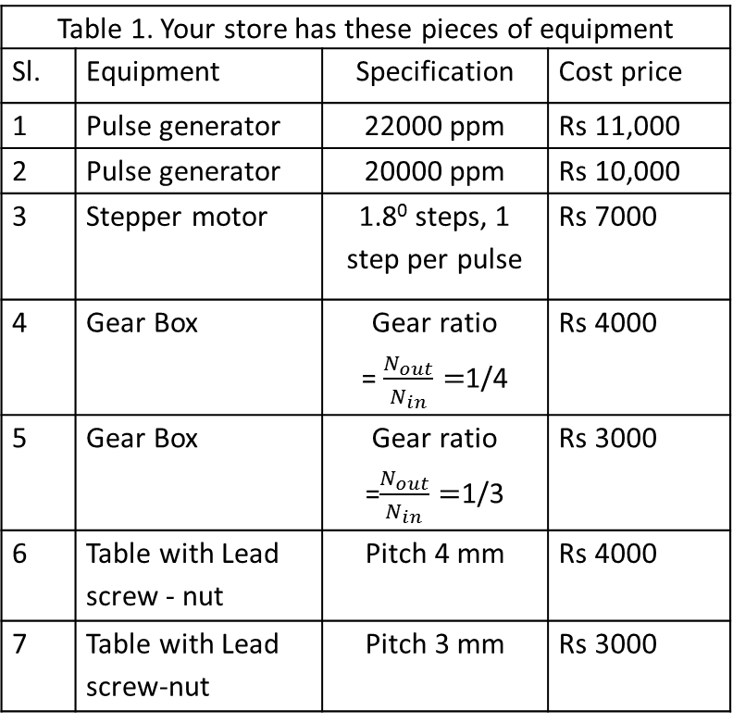
Numerical Problem 3.1
Table 1. Your store has these pieces of equipment
Sl. | Equipment | Specification | Cost price
1 | Pulse generator | 22000 ppm | Rs 11,000
2 | Pulse generator | 20000 ppm | Rs 10,000
3 | Stepper motor | 1.8⁰ steps, 1 step per pulse | Rs 7000
4 | Gear Box | Gear ratio = $\frac{N_{out}}{N_{in}}=$1/4 | Rs 4000
5 | Gear Box | Gear ratio =$\frac{N_{out}}{N_{in}}=$1/3 | Rs 3000
6 | Table with Lead screw - nut | Pitch 4 mm | Rs 4000
7 | Table with Lead screw-nut | Pitch 3 mm | Rs 3000
A company publishes a tender inviting quotations for a CNC PTP control table which moves only in one axis. The Basic length unit (BLU) is to be 5 microns and the axis velocity is to be 100 mm/min.
You represent another company which builds and sells machines by assembling different pieces of equipment (refer table 1).
Check whether you can build a machine to satisfy the above requirements [4] using 1 PG, stepper motor, 1 GB and 1 table.
Verify whether there is any chance that your quoted price (assuming you want to make a profit of only Rs 1000 for the CNC PTP control table) would be lowest, (refer table 2). [4]
 | Quoting company | Quoted price for CNC PTP control table
1 | Lakshmi Brs pvt ltd | Rs 26,500/-
2 | M/c builders Ltd | Rs 25,400/-
3. | CNC & Co. | Rs 24,300/-
4. | Nuts, Bolts & Comps | Rs 32,100/-
5. | Your company | ?

Slide 56
In a CNC machine with contouring control, the following commands are executed :
N01 G90 G00 X100 Y200 Z 20
N02 G01 X130 Y240 F50
What is the feed velocity of the cutter in the X direction in line N02 ?

Slide 57
Incremental format, Feed Calculation
The feed (mm/min) along X axis corresponding to the program line G91G01X40Y30F100 is
80
b. 100
c. 60
d. None of the others
(G91 – incremental)

Slide 58
A CNC user wants to remove a stepper motor from one axis of his CNC drilling machine table and replace it with a PMDC (Permanent magnet direct current) motor. The Stepper motor (1 rotation in 200 steps, 1 step for 1 pulse) received pulses from a pulse generator @ 5000 ppm and was driving a lead screw-nut pair (lead = 4 mm) directly. The PMDC motor rotates at a constant speed of 100 rpm and after fitting, should produce same BLU and axis speed as before. The user may employ any 1 lead screw-nut pair & 1 gear box & 1 encoder combination from inventory listed below. No equipment other than these is permitted. Encoder, if used, should be mounted on lead screw.
encoders
400 holes
300 holes
200 holes
Lead of Lead screw-nut pairs
4 mm
6 mm
8 mm
Gear boxes with ratio
½
¼
⅓

Slide 59
In the CNC machine drill table X-axis drive, a manufacturer has put a DC motor drive as shown below. The Encoder is the BLACK one and the grey encoder is to be ignored at present. Find out the BLU along X drive for the following specs : Number of holes on the black encoder = 200. Lead screw pitch is 5 mm with double start. DC motor recommended speed is 200 rpm. Gear Box ratio ½ When you ask for a lower BLU, the manufacturer suggests that it can be possible by placing the encoder in the grey position. Find the BLU for this case (GREY encoder).(2) The grey encoder is placed away from the table. Does this affect the performance of the system in any way ?
DC motor
Table
Gear Box ½

Slide 60
Questions, MCQ discussions on motors, Encoders, decoders and programming practice
6th Lecture

Slide 61
MCQ 1
What is the purpose of using “recirculating ball screw nut” mechanism in CNC machine
To reduce the set-up time
For higher surface finish
For carrying out Up-milling
To remove backlash

Slide 62
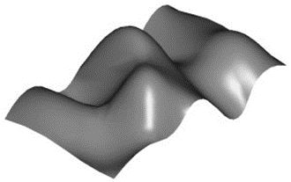
MCQ 2
11. The following surface can be machined on
CNC milling machine (b) CNC lathe
(c) conventional lathe (d) CNC turning center

Slide 63
The main advantage of Computer numerical control (CNC) over conventional automatic control (Fixed automation) is
(a) CNC is stylish while automatic conventional control is not
(b) CNC allows for application of higher cutting speeds and feeds
(c) CNC is applicable in unmanned satellites
(d) CNC offers higher flexibility than conventional automatic control (fixed automation)

Slide 64
MCQ 4
In a CNC machining center, any complex cutting motion involving X, Y and Z axes movements is carried out by
Use of jigs, cams, templates and tracers
Skill of the machine operator
Combination of movements obtained from motors along the axes
None of the others
Using specific gear box settings that distribute power to the axes

Slide 65
MCQ 5
A machine will be said to have CNC control if
The dimensions of the work piece are measured by sensors while cutting goes on
The tool motion is guided by drum cams and disc cams
The loading and unloading of the work piece on and off the machine respectively, is made automatic
Control is achieved by employment of alphanumeric data

Slide 66
(c) In Computer controlled machine tools terminology, a machining center is
(i) The origin of the machine coordinate system with respect to which the operator has to make his program
(ii) The center of the cutter which actually goes to the programmed point (when used without radius compensation)
(iii) A computer control machine tool capable of a variety of operations involving rotating cutters
(iv) None of the others

Slide 67
a) In Computer controlled machine tools, tool movements are controlled by :
Cam (ii) Machine Operator
(iii) Fool proof mechanism (iv) None of the others

Slide 68
MCQ 8
Holes are to be drilled on the circumference of a circle with regular angular spacing. If a CNC machine is used, it should essentially
Have one indexing head mounted on the machine table
Have a CNC rotary axis of motion to rotate the table about Z axis (in addition to X, Y and Z axes of motion)
Be a CNC milling machine with contouring control
None of the others

Slide 69
MCQ - 9

Slide 70
MCQ 10
A CNC machine tool has continuous path control (both linear and circular) along X, Y and Z axes and control of table rotations about X axis and about Z axis. This machine should be called :
a. 2C, L b. 3L, 2C c. 5C d. None of the others

Slide 71
For milling a bi-laterally symmetrical 2-D profile on metal plate 10 mm thick, a CNC milling machine would require the following accessory / attachment
Copy milling attachment
Dividing head
Reversing table
Rotary table
None of the above

Slide 72
In order to produce a circular groove by milling in CNC machining centre
A Universal Dividing head is necessary
A planetary gear mechanism actuates table movement
A Rotary table is necessary
None of the above

Slide 73
CNC is not applicable in
Drilling machine
Milling machine
Lathe
All of the above
None of the above

Slide 74
A CNC machine tool has the following advantage over conventionally controlled machine tools
Surface finish of machined part is higher
Cutting forces are less
Cutting temperature is lower
All of the above
None of the above

Slide 75
The incremental encoder is capable of sensing
Direction of movement of the table
Direction of rotation of the lead screw
Direction of rotation of the motor
None of the others

Slide 76
In a PTP machine feed axis employing a stepper motor as prime mover
An encoder for position feedback is a must
An interpolator is a must
A tachogenerator is a must
None of the others

Slide 77
A ⊕ B is equal to
A.B + A’. B’
A’.B + A.B
A’.B + B’. A
None of the others

Slide 78
A CNC milling machine would have
PTP open loop control only
PTP closed loop control only
Contouring control
None of the above

Slide 79
5. The function of Tachogenerator is
Reduction of BLU (Basic Length Unit)
Faster response of motor
To make 3-D interpolation possible
None of the above

Slide 80
CNC machines find the widest application in the field of
Mass production
Small lot and batch production
Non-conventional machining
None of the above

Slide 81
CNC machining has the following main advantage over conventional machining practice
Ability to employ higher cutting speeds, feeds and depths of cut
Flexibility
Feedback control
None of the others

Slide 82
9. On the CNC lathe
2-D programming is sufficient
3-D programming is necessary
1-D programming is sufficient
None of the above

Slide 83
10. Interpolator is present in case of
PTP (Point to point) open loop system
PTP (Point to point) closed loop system
Contouring control system
None of the others

Slide 84
In a CNC turning center, threads of different pitches are cut by
Different settings of the Meander drive and Norton-tumbler gears
Different settings of the feed gear box
Different setting of the speed gear box
None of the others

Slide 85
5. A point-to-point (PTP) control CNC machine
a. Does not have an interpolator
b. Does not have a position down counter
c. Never has DC motor as prime mover along any feed axis
d. None of the others

Slide 86
CNC machines find the widest application in the field of
Mass production
Small lot and batch production
Non-conventional machining
Machining of hard substances
None of the others

Slide 87
2. In a CNC milling machine, a circular cut is always produced a. by operator's skill and experience b. by copy milling from a master circular shape c. By combined motion of feed axes d. None of the others

Slide 89
In case of a CNC drilling machine, whenever there is table motion, the speed of X-Y table along X axis
Is always same
Can be different for different lines of program
Is always 0
None of the others

Slide 90
CNC machines have the ability to cut complex profiles as
They are equipped with tracer control
The accuracy of the axes movements is very high
They are equipped with high performance gear boxes
None of the above

Slide 91
A recirculating ball screw-nut assembly can be used for
Elimination of backlash
Elimination of stick-slip motion
Elimination of Gear box
None of the above

Slide 92
In order to cut complex profiles, CNC machines
Employ gear drives
Employ Cam controlled mechanisms
Employ tracer controlled mechanism
None of the above

Slide 93
Backlash elimination in CNC machines with contouring control system can be done by
Always completing motion along any feed axis in one particular direction.
Grey coded encoder disc
Half-nut
None of the others

Slide 94
The encoder with grey code
Eliminates counting errors
Senses direction
Determines absolute position
None of the others

Slide 95
Three axis CNC machines cannot cut all forms of surfaces because
The real world is 4-dimensional
Surfaces might have re-entrant sides
Five axis machine manufacturers hold a patent on machining some kind of surfaces
Three axis machines cannot produce uniform surface roughness as five axis machines do
None of the above

Slide 96
PTP (Point to point) control of CNC machines is not applicable in case of
Drilling of holes at the vertices of a triangle
Drilling of 73 holes at regular angular intervals on the circumference of a circle
Drilling of holes at intervals of 3 cm on any straight line on XY plane
None of the others

Slide 97
In a CNC machine, complex profiles are cut with the help of
Synchromesh gear boxes in every feed axes of machine
A combination of axes velocities which are infinitely variable
Cam control
None of the others

Slide 98
Stepper motor
What is a stepper motor ?
A stepper motor is a device which can execute motion in discrete angular steps in response to voltage pulses given to it in a definite pattern and sequence

Slide 99
Stepper motors contd…
In commercially available stepper motors, one rotation of the motor shaft is generally carried out in 200 steps
Hence, 1 step is equal to 1.8 degrees

Slide 100
Input given to a stepper motor
Voltage pulses along cables in this pattern and sequence
 | Cable 1 | Cable 2 | Cable 3 | Cable 4
Signal | 5V | 0V | 5V | 0V
↓ | 0V | 5V | 5V | 0V
 | 0V | 5V | 0V | 5V
 | 5V | 0V | 0V | 5V
 | 5V | 0V | 5V | 0V
Cable 4
Cable 3
Stepper motor
Cable 1
Cable 2
Power

Slide 101



The stepper motor rotor as a magnetic needle
Cable 4
Cable 3
S
N
Cable 1
Cable 2
Power

Slide 102
The rotor of the stepper motor as a special type of permament magnet

Slide 103




Stator and rotor poles
Rotor has 50 N poles (White) + 50 S poles (Black).
For 8 pole stator,
Same colour means same polarity.
Black & yellow
Green & orange controlled together

Slide 104



Stator and rotor poles
N
N
S

Slide 105
Stator and rotor poles
N
N
S

Slide 106
Stator and rotor poles
N
N
S

Slide 107





In a degree span, 6.25 S-poles

Slide 108
In a degree span, 6.25 S-poles

Slide 109

What does the rotor look like
S
N

Slide 110
Stepper motors – contd…
How can we make a stepper motor rotate by 0.9 degrees ?
By sequentially putting one signal pair off
 | Cable 1 | Cable 2 | Cable 3 | Cable 4
 | 1 | 0 | 1 | 0
 | 0 | 0 | 1 | 0
 | 0 | 1 | 1 | 0
 | 0 | 1 | 0 | 0
 | 0 | 1 | 0 | 1
 | 0 | 0 | 0 | 1
 | 1 | 0 | 0 | 1
 | 1 | 0 | 0 | 0

Slide 111
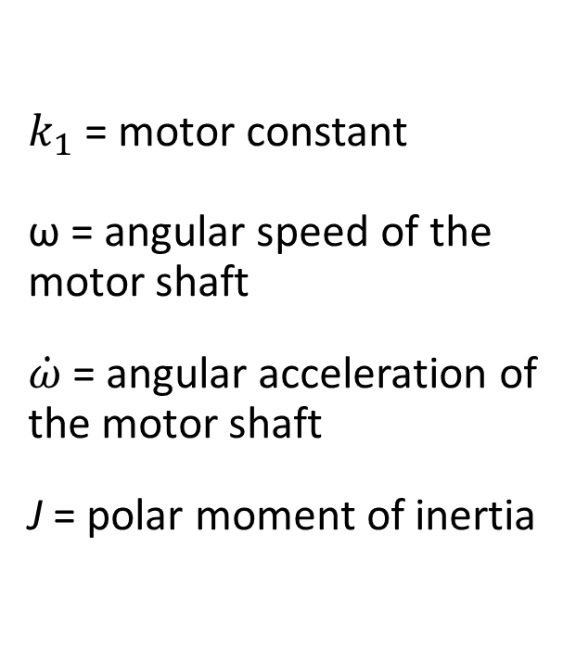
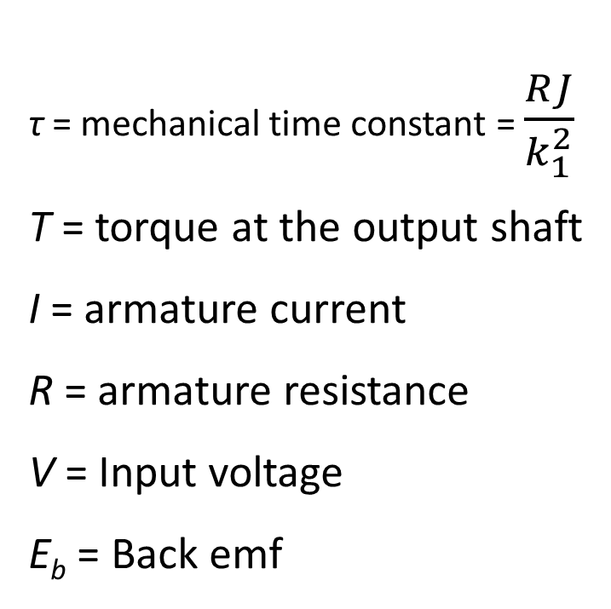
Basic definitions for DC motors
τ= mechanical time constant = $\frac{RJ}{k_{1}^{2}}$
T = torque at the output shaft
I = armature current
R = armature resistance
V = Input voltage
E_{b} = Back emf
$k_{1}$ = motor constant
ω= angular speed of the motor shaft
$\dot{ω}$ = angular acceleration of the motor shaft
J = polar moment of inertia

Slide 112
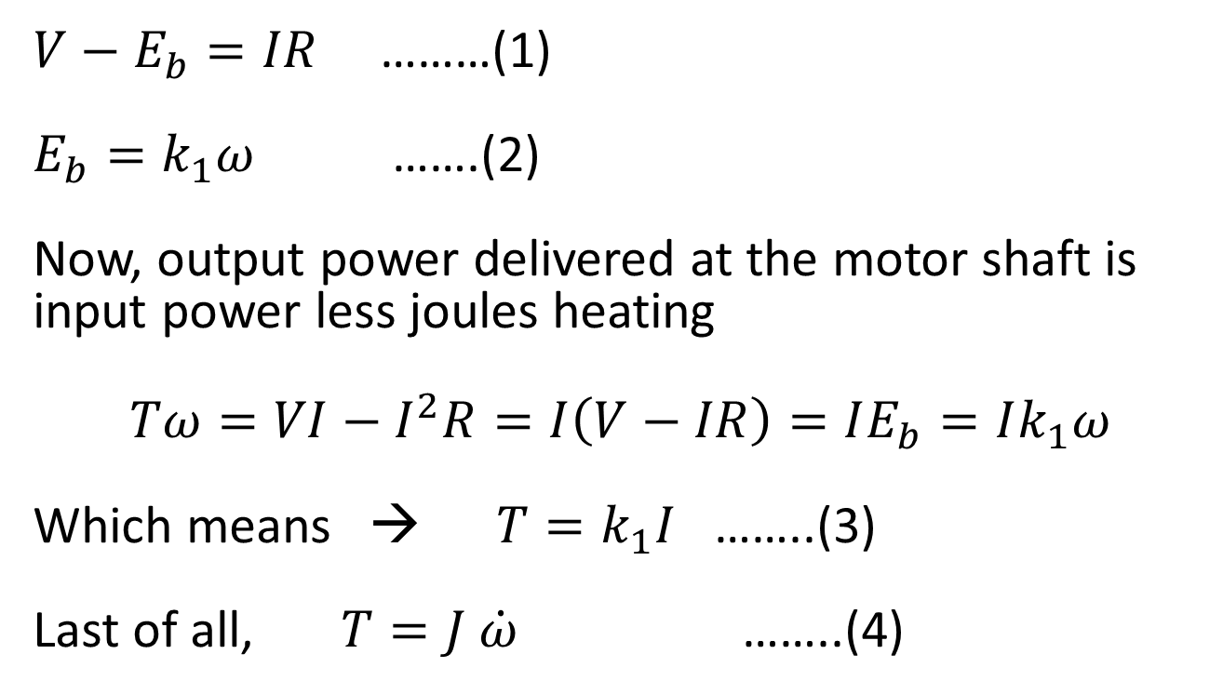
PMDC – Response to step voltage
$V−E_{b}=IR$ ………(1)
$E_{b}=k_{1}ω$ …….(2)
Now, output power delivered at the motor shaft is input power less joules heating
$$Tω=VI−I^{2}R=I\left(V−IR\right)=IE_{b}=Ik_{1}ω$$
Which means →$T=k_{1}I$ ……..(3)
Last of all, $T=J \dot{ω}$ ……..(4)

Slide 113
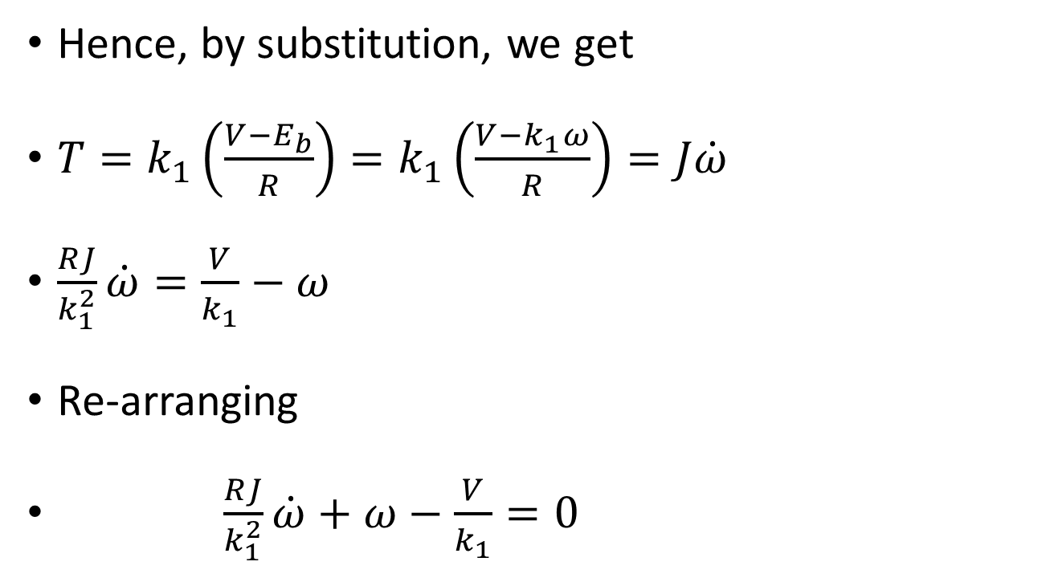
PMDC motor – cotd.
Hence, by substitution, we get
$T=k_{1}\left(\frac{V−E_{b}}{R}\right)=k_{1}\left(\frac{V−k_{1}ω}{R}\right)=J\dot{ω}$
$\frac{RJ}{k_{1}^{2}}\dot{ω}=\frac{V}{k_{1}}−ω$
Re-arranging
$\frac{RJ}{k_{1}^{2}}\dot{ω}+ω−\frac{V}{k_{1}}=0$

Slide 114
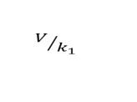
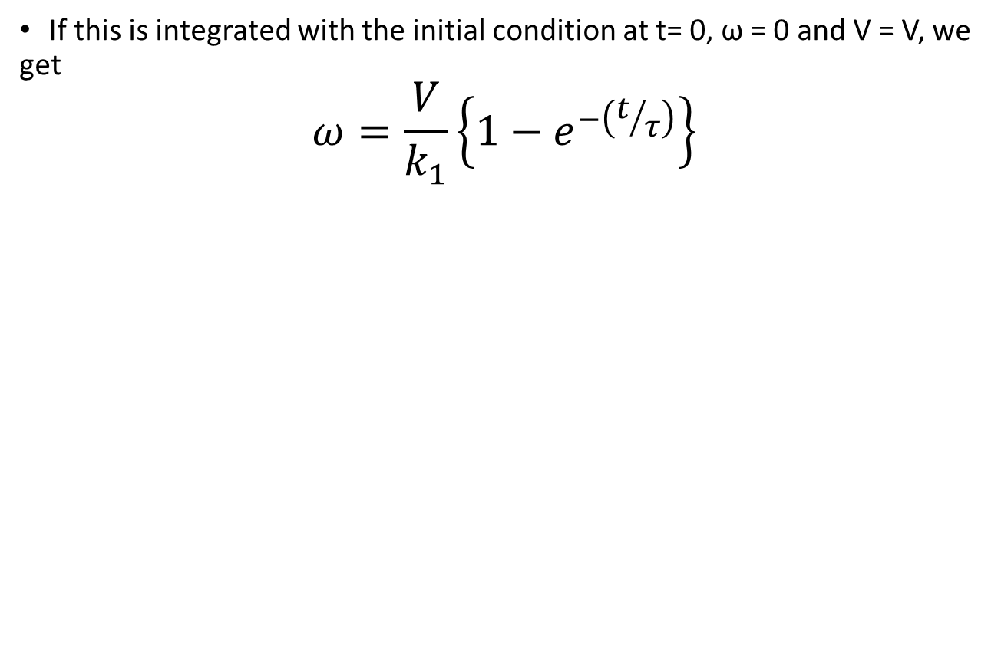
Build-up of angular speed with time for step voltage
If this is integrated with the initial condition at t= 0, ω = 0 and V = V, we get
$$ω=\frac{V}{k_{1}}\left\{1−e^{−\left(t/τ\right)}\right\}$$
ω
$$V/{k_{1}}$$
t

Slide 115
Time constant τ
Value of time constant τ should be low – otherwise system response is sluggish
Time constant can be evaluated by equating t = τ
Time constant can be reduced by controlling the factor T/J – which is basically angular acceleration
Time constant can also be reduced by incorporation of Tachogenerator

Slide 116
An innovative student develops a tachometer (instrument which can measure rotational speeds of rotating shafts) by employing simple digital devices. The figure shows a motor shaft connected to the input shaft of the tachometer. When the motor rotates, it makes the input shaft rotate at the same speed. The input shaft has an encoder mounted on it with 64 holes. The 8-bit position down counters are down-counted by the pulses they receive, each pulse making 1 decrement. After connecting the input shaft to the rotating shaft of the motor (whose rpm is to be measured), the two PDCs are filled completely and instrument is started. If PDC1 = 0 and PDC2 = 204, whats the rpm of the motor?
OR
P | D | C | 1
rMotor
INPUT
OR
Pulse generator 64 pps
P | D | C | 2

Slide 117
The rate at which pulses are coming from the motor encoder = 64*N (Where N = rps)
Time required to empty PDC1 = 255/(64*N)
Time required to reduce PDC2 to 204 = 51/64
255/(64*N)=51/64

Slide 118
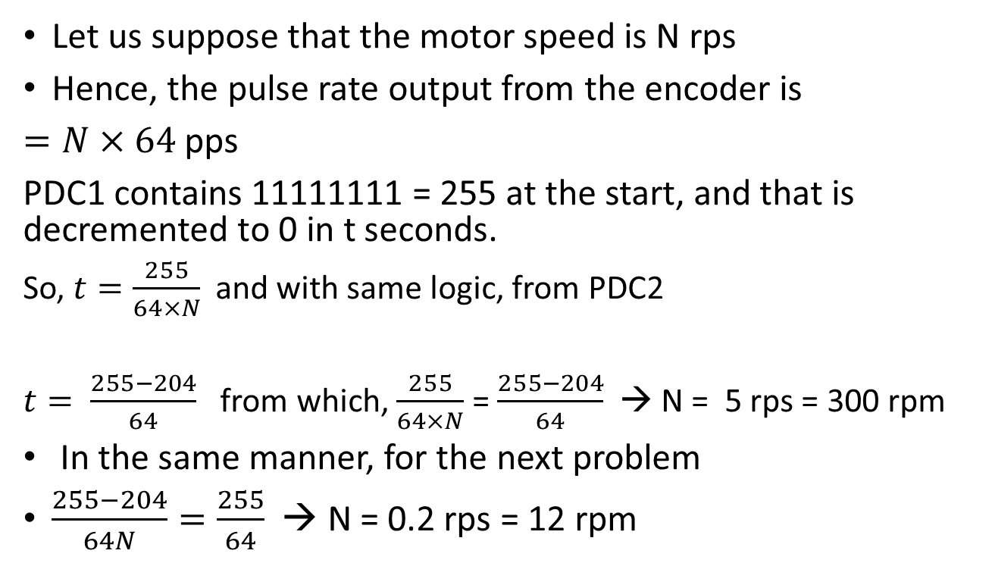
How much is the speed of the motor shaft if instrument shows unchanging values of PDC1 = 0 and PDC2 = 204 after some time. How much is the speed of the motor shaft if instrument shows unchanging values of PDC1 = 204 and PDC2 = 0 after some time.
Let us suppose that the motor speed is N rps
Hence, the pulse rate output from the encoder is
$=N×64$pps
PDC1 contains 11111111 = 255 at the start, and that is decremented to 0 in t seconds.
So, $t=\frac{255}{64×N}$ and with same logic, from PDC2
$t= \frac{255−204}{64}$ from which, $\frac{255}{64×N}$ = $\frac{255−204}{64}$→ N = 5 rps = 300 rpm
In the same manner, for the next problem
$\frac{255−204}{64N}=\frac{255}{64}$→ N = 0.2 rps= 12 rpm

Slide 119
One problem on decoder
In a workshop – an alarm system is incorporated such that the maintenance section is informed the moment any one or more of six machines are down. If a machine is up it emits 1 otherwise 0. The maintenance section wants a 1 as an alarm. In that case – what should be the circuit which will make this possible.

Slide 120
A Decoding circuit is to be designed which detects whether the CNC table is 5 BLU or less away from the target location. If so, it sends out a signal d = 1 to the pulse generator. Design this decoding circuit A.
Part of the required circuit is already provided. Unless the 4 most significant bits are zeros, the OR gate OR1 wont send out a 0. Now if the decoding circuit is to work , it should send out a 1 for 101, 100, 011, 010, 001 and 000. Contd. In next page….
d
Decoding circuit A
OR1
Pulse Generator, 100 ppm
AND Gate
0 | 0 | 0 | 0 | a | b | c
Position down counter
OR Gate OR2
End of count
Lead screw 4 mm pitch, 2 start
CNC Table X →
Motor driver
Stepper Motor, 200 Steps/rev
Gear box Ratio = ¼

Slide 121
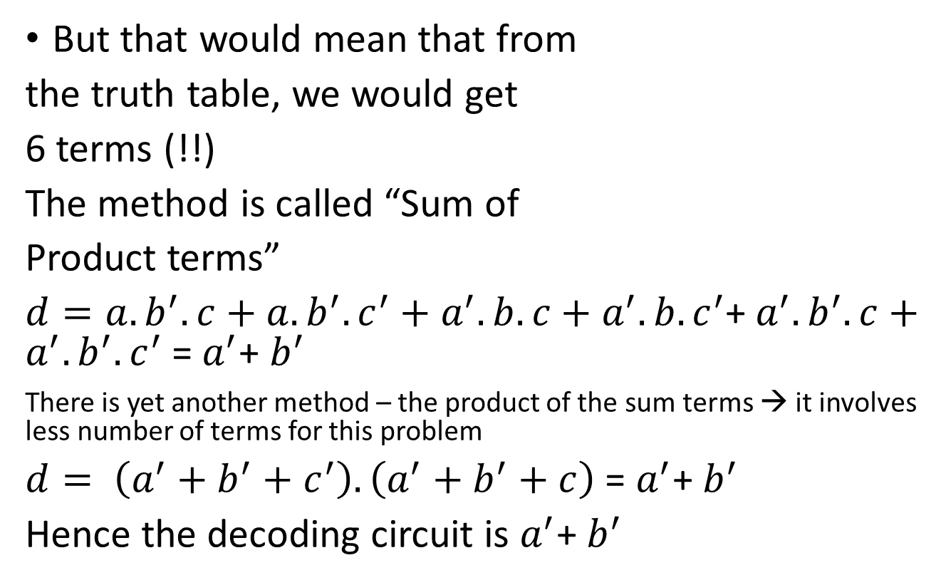
Decoding circuit problem contd…
a | b | c | d
1 | 1 | 1 | 0
1 | 1 | 0 | 0
1 | 0 | 1 | 1
1 | 0 | 0 | 1
0 | 1 | 1 | 1
0 | 1 | 0 | 1
0 | 0 | 1 | 1
0 | 0 | 0 | 1
But that would mean that from
the truth table, we would get
6 terms (!!)
The method is called “Sum of
Product terms”
$d=a.b^{′}.c+a.b^{′}.c^{′}+a^{′}.b.c+a^{′}.{b.c}^{′}$+${ a}^{′}.b^{′}.c+a^{′}.{b^{′}.c}^{′}$= $a^{′}$+ $b^{′}$
There is yet another method – the product of the sum terms → it involves less number of terms for this problem
$d= \left(a^{′}+b^{′}+c^{′}\right).\left(a^{′}+b^{′}+c\right)$ = $a^{′}$+ $b^{′}$
Hence the decoding circuit is $a^{′}$+ $b^{′}$

Slide 122
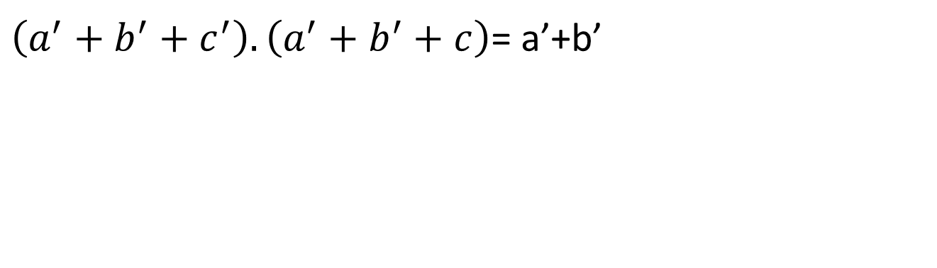
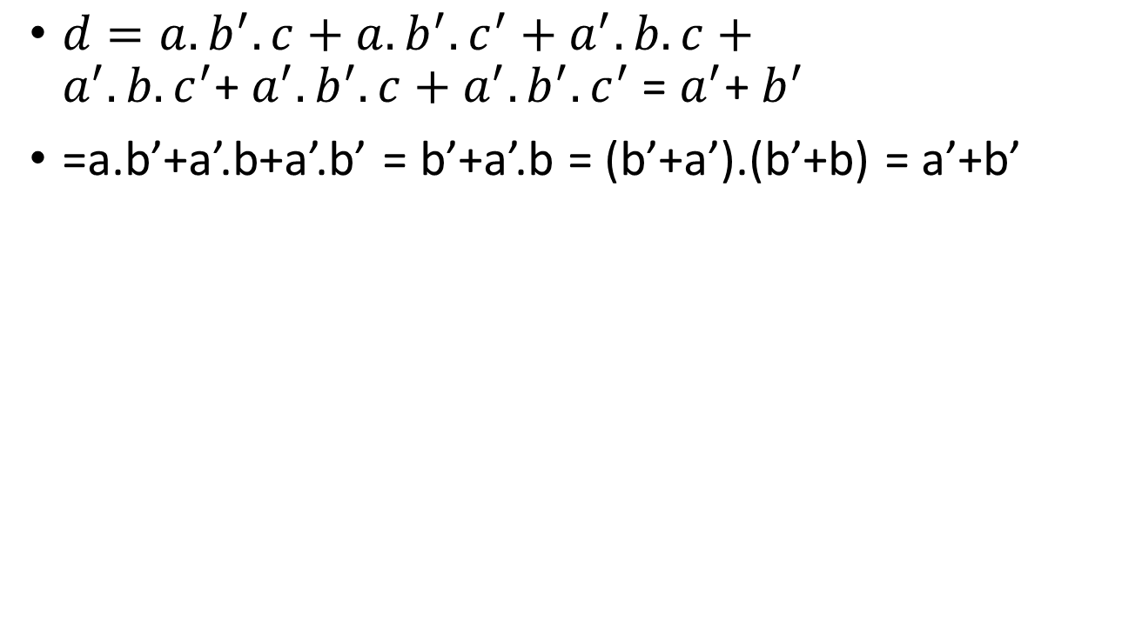
a+a.b = a.1+a.b = a.(1+b) = a
$d=a.b^{′}.c+a.b^{′}.c^{′}+a^{′}.b.c+a^{′}.{b.c}^{′}$+${ a}^{′}.b^{′}.c+a^{′}.{b^{′}.c}^{′}$= $a^{′}$+ $b^{′}$
=a.b’+a’.b+a’.b’ = b’+a’.b = (b’+a’).(b’+b) = a’+b’
$\left(a^{′}+b^{′}+c^{′}\right).\left(a^{′}+b^{′}+c\right)$= a’+b’

Slide 123
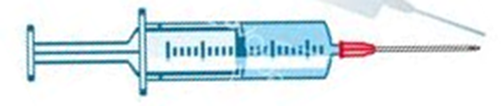
Do it yourself exercises
Design the electronic controls of this medical instrument portable infusion pump which can maintain very low flow rates of liquid medicine to be injected. Given
Syringe inner cross section = 4 sq. mm
The gear box ratio is ¼ (= lead screw RPM / stepper motor RPM), the single start lead screw has a pitch of 1 mm. The stepper motor shaft rotates by one step of 1.8⁰ for each pulse received from pulse generator. 1 pulse → 1 step → 1 drop of liquid
Find out the volume of liquid in one drop of delivered medicine
Select f that would result in a delivery rate of 0.5 cu.mm of liquid medicine per min
Ans – Vol of one drop of liquid medicine = 0.005 cu.mm and f = 100 ppm
Pulse generator
Motor driver
Stepper motor
(1/200)*(1/4)*4=0.005
f*0.005=0.5 → f= 100
f
Gear box, ¼
Nut, pitch
1 mm
Lead screw

Slide 124

The digital differential analyser (DDA)
The overflow pulse rate = $\frac{f×X}{2^{n}}$
2^{n} pulses of f will be required to output 1 overflow pulse if X=1
2^{n} /X pulses of f will be required to output 1 overflow pulse if X=X
1 pulse of f train → X/2^{n} overflow pulses
f pulses produce fX/2^{n} overflow

Slide 125
A prospective customer of a CNC P-T-P table wants X-axis BLU to be halved and X-axis table speed to be doubled. The X-axis employs: Pulse generator-stepper motor (200 steps per revolution, 1 steps per pulse) – gearbox (ratio ½ ) – lead screw (pitch 4 mm). One solution is to
Simply add a DDA with n = 2 and X = 2 in between pulse generator and motor
Remove gear box
Quadruple pulse generator frequency and add a DDA with n=2 and X=2
None of the others

Slide 126
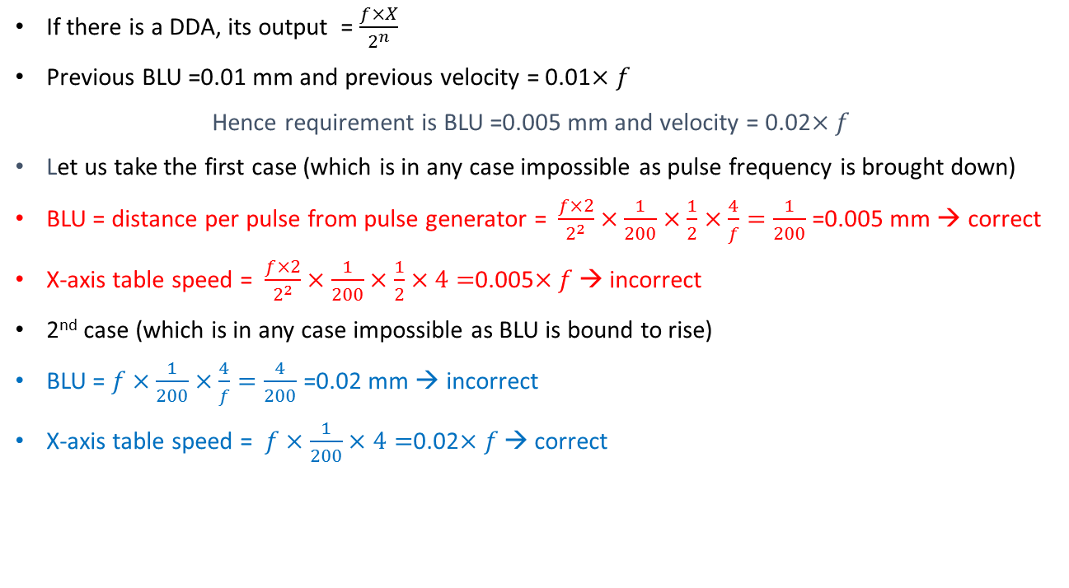
If there is a DDA, its output = $\frac{f×X}{2^{n}}$
Previous BLU =0.01 mm and previous velocity = 0.01$×f$
Hence requirement is BLU =0.005 mm and velocity = 0.02$×f$
Let us take the first case (which is in any case impossible as pulse frequency is brought down)
BLU = distance per pulse from pulse generator = $\frac{f×2}{2^{2}}×\frac{1}{200}×\frac{1}{2}×\frac{4}{f}=\frac{1}{200}$ =0.005 mm → correct
X-axis table speed = $\frac{f×2}{2^{2}}×\frac{1}{200}×\frac{1}{2}×4=$0.005$×f$→ incorrect
2nd case (which is in any case impossible as BLU is bound to rise)
BLU = $f×\frac{1}{200}×\frac{4}{f}=\frac{4}{200}$ =0.02 mm → incorrect
X-axis table speed = $f×\frac{1}{200}×4=$0.02$×f$→ correct

Slide 127
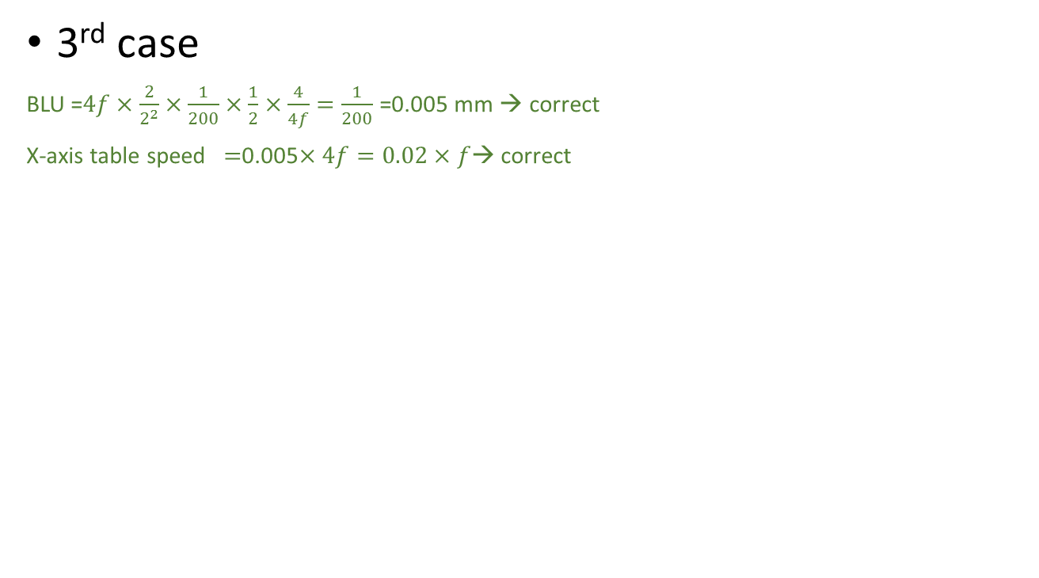
MCQ contd…
3rd case
BLU =$4f×\frac{2}{2^{2}}×\frac{1}{200}×\frac{1}{2}×\frac{4}{4f}=\frac{1}{200}$ =0.005 mm → correct
X-axis table speed $=$0.005$×4f=0.02×f$→ correct

Slide 128
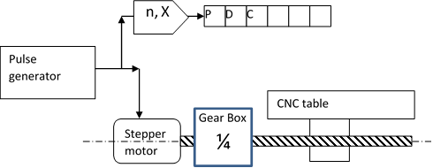

The overflow pulse rate = $\frac{f×5}{2^{3}}$
A stepper motor of 200 steps per revolution was connected via a ¼ ratio gearbox to a leadscrew of 5 mm pitch.
The basic length unit (BLU) is
a. 5 microns b. 2 microns c. 6.25 microns d. None of these
2. The steps are counted down in a position down counter (PDC) as shown in Fig. It is desired by a customer that each bit of the counter represent 10 microns. This can be done by attaching a DDA as shown with
a. n = 8 and X = 5 b. n = 2 and X = 3 c. n = 3 and X = 5 d. None of these
6.25x8=50, 10x5 =50

Slide 129
BLU =(1/200)×(1/4)×5 = 0.00625 mm
By the time 8 pulses are sent to the motor to give 8 × 0.00625 = 0.05
If you send 5 pulses to the PDC – it will show decrements of 5 bits. Hence these bits would represent 50 microns so 1 bit would represent 10 microns.
Use a DDA with n = 3 and X = 5

Slide 130
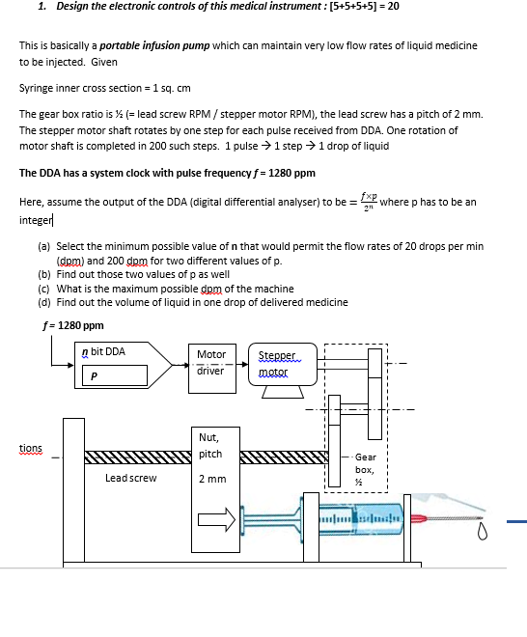
Select the minimum value of n that would permit the delivery rates of 20 drops per min (dpm) and 200 dpm for different value of X.
Find out those two values of X as well
Find out the maximum dpm of the machine
What is the volume of 1 drop of medicine ?

Slide 131
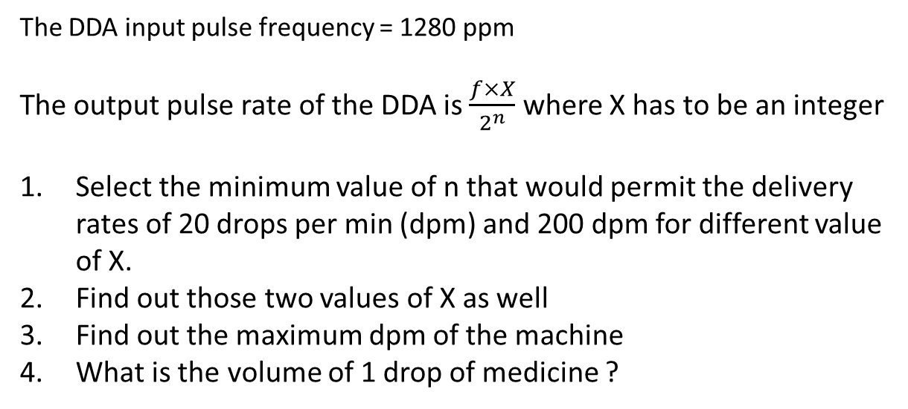
The DDA input pulse frequency = 1280 ppm
The output pulse rate of the DDA is $\frac{f×X}{2^{n}}$ where X has to be an integer
Select the minimum value of n that would permit the delivery rates of 20 drops per min (dpm) and 200 dpm for different value of X.
Find out those two values of X as well
Find out the maximum dpm of the machine
What is the volume of 1 drop of medicine ?

Slide 132
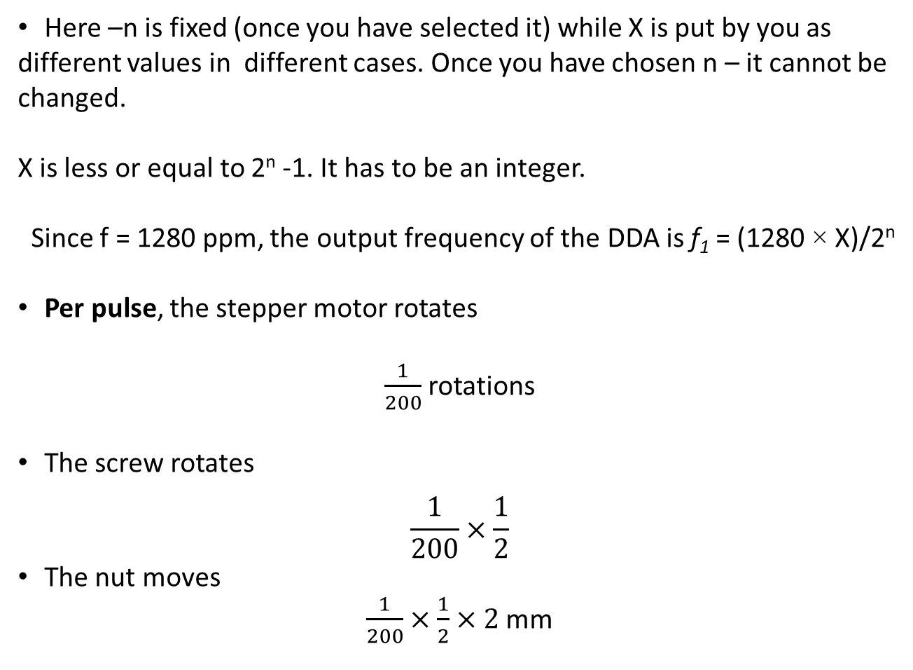
Here –n is fixed (once you have selected it) while X is put by you as different values in different cases. Once you have chosen n – it cannot be changed.
Xis less or equal to 2^{n} -1. It has to be an integer.
Since f = 1280 ppm, the output frequency of the DDA is f₁ = (1280 × X)/2^{n}
Per pulse, the stepper motor rotates
$\frac{1}{200}$ rotations
The screw rotates
$$\frac{1}{200}×\frac{1}{2}$$
The nut moves
$\frac{1}{200}×\frac{1}{2}×2$ mm

Slide 133
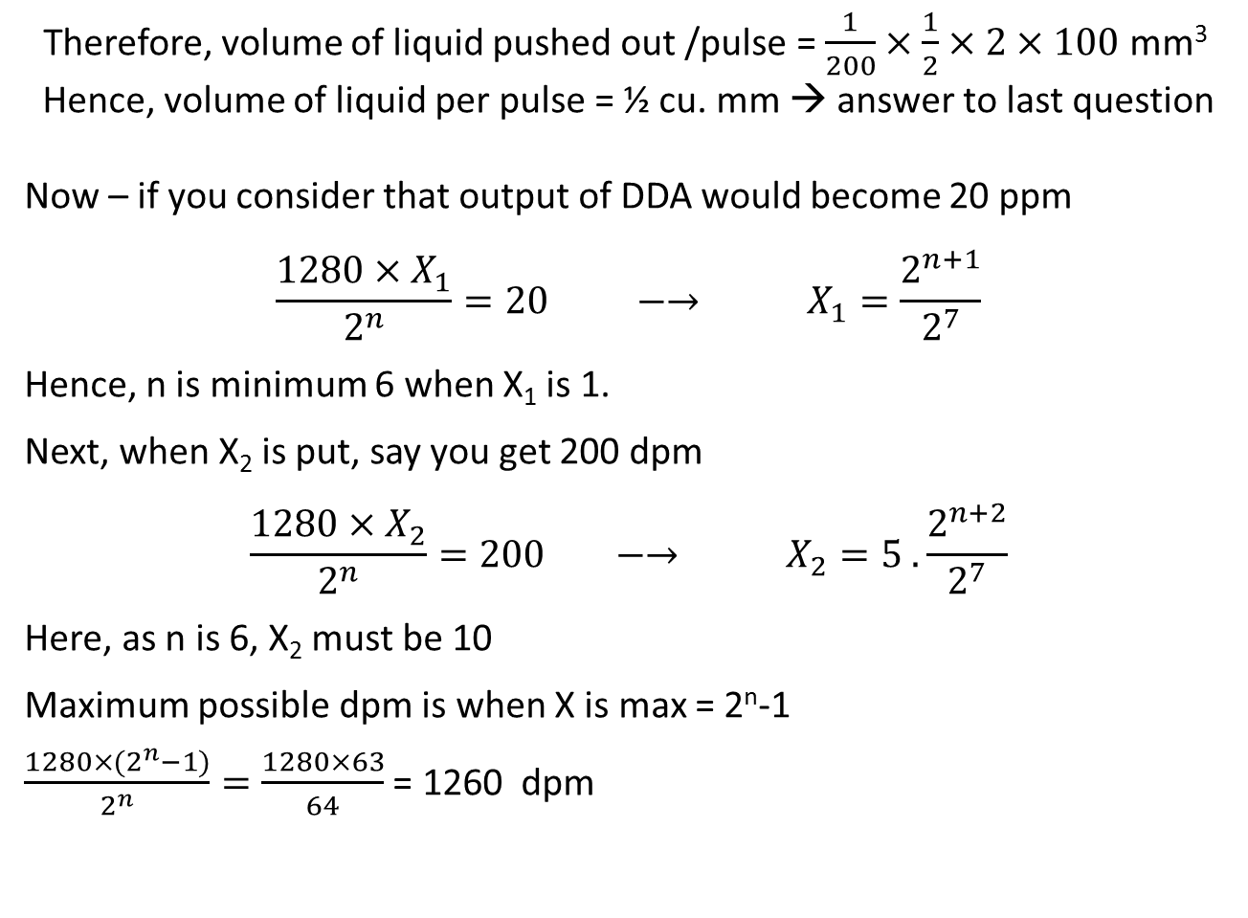
Therefore, volume of liquid pushed out /pulse = $\frac{1}{200}×\frac{1}{2}×2×100$mm³
Hence, volume of liquid per pulse = ½ cu. mm → answer to last question
Now – if you consider that output of DDA would become 20 ppm
$$\frac{1280×X_{1}}{2^{n}}=20 −→ X_{1}=\frac{2^{n+1}}{2^{7}}$$
Hence, n is minimum 6 when X₁is 1.
Next, when X₂is put, say you get 200 dpm
$$\frac{1280×X_{2}}{2^{n}}=200 −→ X_{2}=5 .\frac{2^{n+2}}{2^{7}}$$
Here, as n is 6, X₂must be 10
Maximum possible dpm is when X is max = 2^{n}-1
$\frac{1280×{(2}^{n}−1)}{2^{n}}=\frac{1280×63}{64}$= 1260 dpm

Slide 134
There is one Covid-19 curing pill vending machine, which vends one 1 curing pill per pulse. The machine has to serve one pill per person.
Given f = 480 ppm (always on) acting as the input clock to a 3-bit DDA based control circuit as shown. Output pulses from DDA decreases the content of Down counter by 1 bit per pulse. The downcounter is initially filled with a particular number D in binary and machine is started and goes on vending till it stops by itself. Reservoir of pills inside machine is infinite. All bits of Downcounter are input to End of count (OR Gate).
The value X inside the DDA is equal to 480. X/2^{n}
i) Frequency of pill vending (pills per second)
ii) Number of pills vended before machine stops
iii) The number of hours of service
iv)None of these
D | o | w | n |  | C | o | u | n | t | e | r
3 bit DDA
End of count (OR gate)
(
X added repeatedly
Covid-19 curing pill vending machine, 1 pill per pulse

Slide 135
The value D put initially inside the downcounter is equal to
Frequency of pill vending
Number of pills vended before machine stops
The number of hours of service
None of these

Slide 136
The value X inside the DDA is equal to
i) Frequency of pill vending (pills per second)
ii) Number of pills vended before machine stops
iii) The number of hours of service
iv)None of these

Slide 137
480 x 7/8 = 60 x 7 21000/(60 x 7)= 50
If 21000 people are infected in one day and have to be provided with 1 pill each, the least amount of time taken by the pill vending machine is
Between 45 and 55 minutes
Between 56 minutes and 1 hour
Between 35 minutes and 44 minutes
None of these

Slide 138
You get recruited by DRDO (defense research and development organization) for developing anti air craft firing control circuit.
They make it simple for you – the circuit is already chosen – it consists of a pulse generator feeding pulses to a DDA which generates overflow pulses which makes the gun fire.
Pulse generator
n bit DDA
The Gun
Now, you have to select the Output pulse rate of the pulse generator (f), the size of the counters inside the DDA (n) and the numbers (in binary) to be put inside the n bit register of the DDA so that you can have firing rates of 125 bullets per minute (bpm), 500 bpm and 1000 bpm.
So find out f, n, X1, X2 and X3

Slide 139
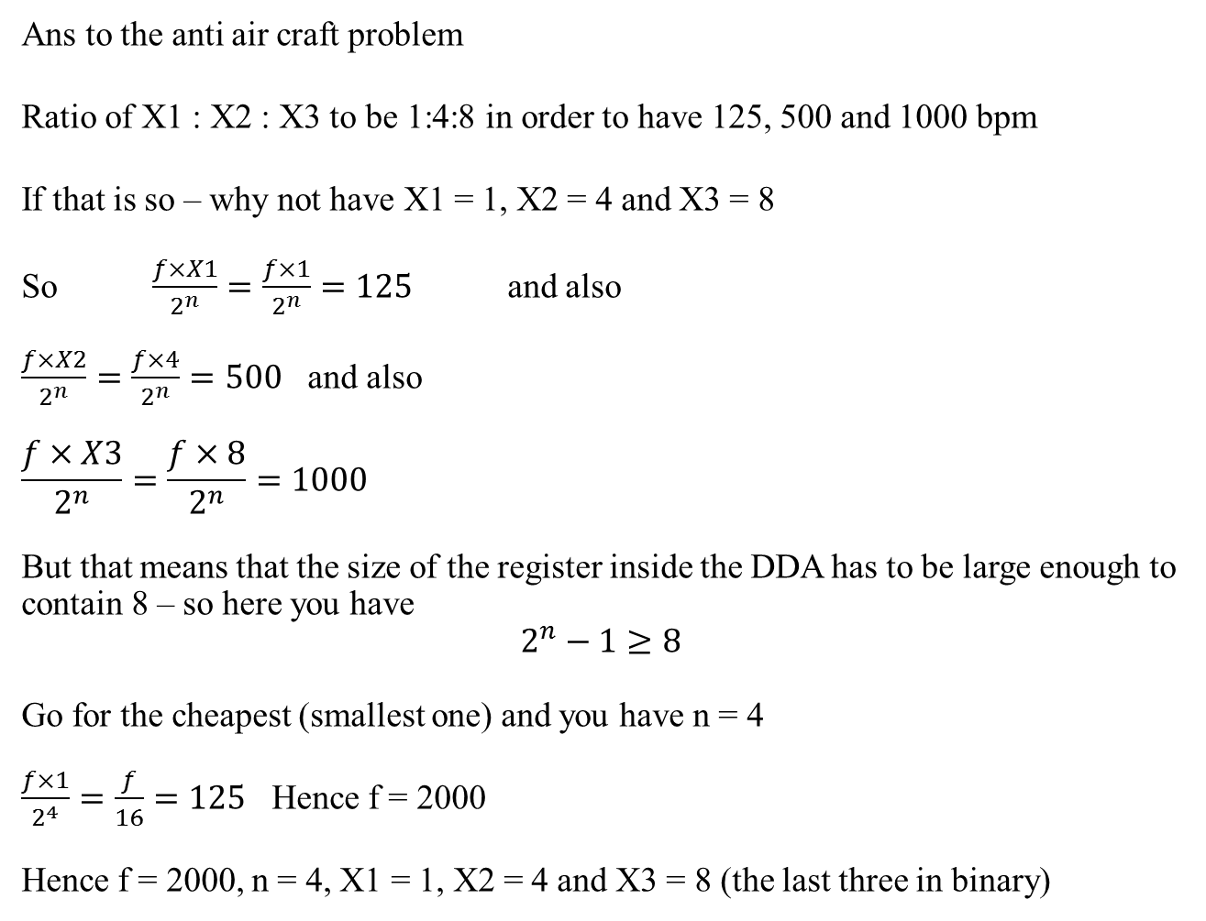
Ans to the anti air craft problem
Ratio of X1 : X2 : X3 to be 1:4:8 in order to have 125, 500 and 1000 bpm
If that is so – why not have X1 = 1, X2 = 4 and X3 = 8
So $\frac{f×X1}{2^{n}}=\frac{f×1}{2^{n}}=125$ and also
$\frac{f×X2}{2^{n}}=\frac{f×4}{2^{n}}=500$ and also
$$\frac{f×X3}{2^{n}}=\frac{f×8}{2^{n}}=1000$$
But that means that the size of the register inside the DDA has to be large enough to contain 8 – so here you have
$$2^{n}−1≥8$$
Go for the cheapest (smallest one) and you have n = 4
$\frac{f×1}{2^{4}}=\frac{f}{16}=125$ Hence f = 2000
Hence f = 2000, n = 4, X1 = 1, X2 = 4 and X3 = 8 (the last three in binary)

Slide 140
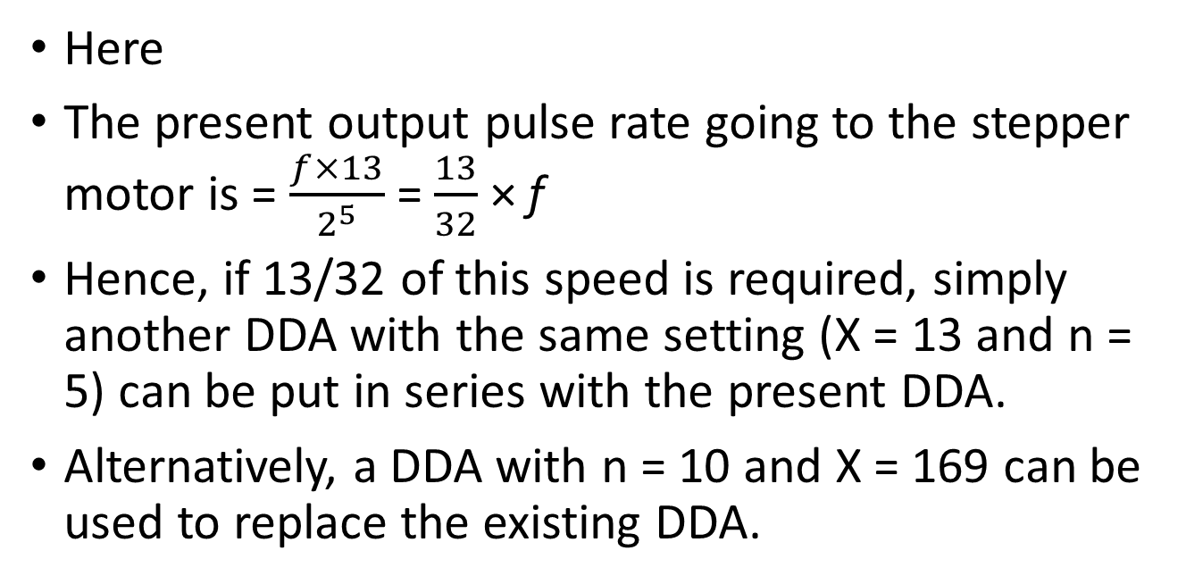
You start a company which makes escalators. The prime mover is a stepper motor which gets pulses from a Digital differential analyser (DDA) which has X = 13 and n = 5. The DDA is run by a pulse train of frequency f. It is required to modify the speed of the escalator to 13/32 of its present speed. How will you do it ? No gearbox allowed.
Here
The present output pulse rate going to the stepper motor is = $\frac{f×13}{2^{5}}$ = $\frac{13}{32}$ × f
Hence, if 13/32 of this speed is required, simply another DDA with the same setting (X = 13 and n = 5) can be put in series with the present DDA.
Alternatively, a DDA with n = 10 and X = 169 can be used to replace the existing DDA.

Slide 141
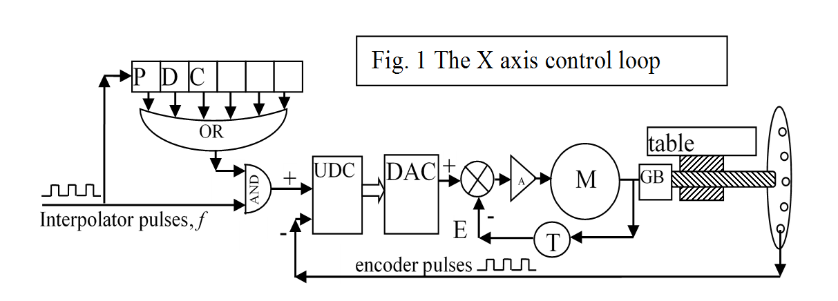
Tachogenerator in CNC systems
A Tachogenerator is a direct current motor run as a generator and placed in the continuous control loop and feeds back its DC output voltage.
It reduces the value of the time constant
of response of the CNC feed axis

Slide 142
How does the tachogenerator work
K_{A}
V
+
PMDC Motor
DC generator
_
V_{T} = K_{T} ω

Slide 143
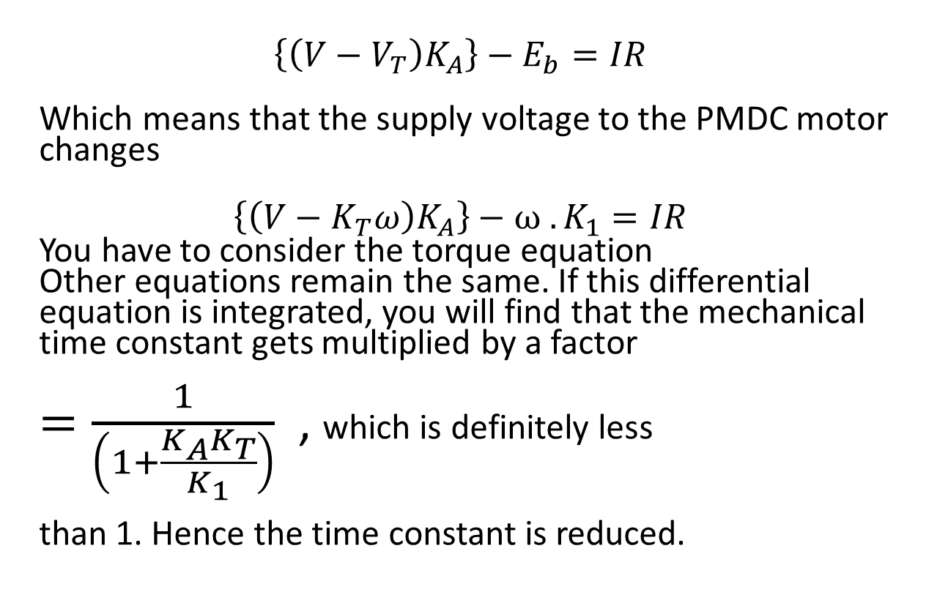
Tachogenerator – Contd…
$$\left\{\left(V−V_{T}\right)K_{A}\right\}−E_{b}=IR$$
Which means that the supply voltage to the PMDC motor changes
$$\left\{\left(V−K_{T}ω\right)K_{A}\right\}−{ω .K}_{1}=IR$$
You have to consider the torque equation
Other equations remain the same. If this differential equation is integrated, you will find that the mechanical time constant gets multiplied by a factor
$=\frac{1}{\left(1+\frac{K_{A}K_{T}}{K_{1}}\right)}$ , which is definitely less
than 1. Hence the time constant is reduced.

Slide 144
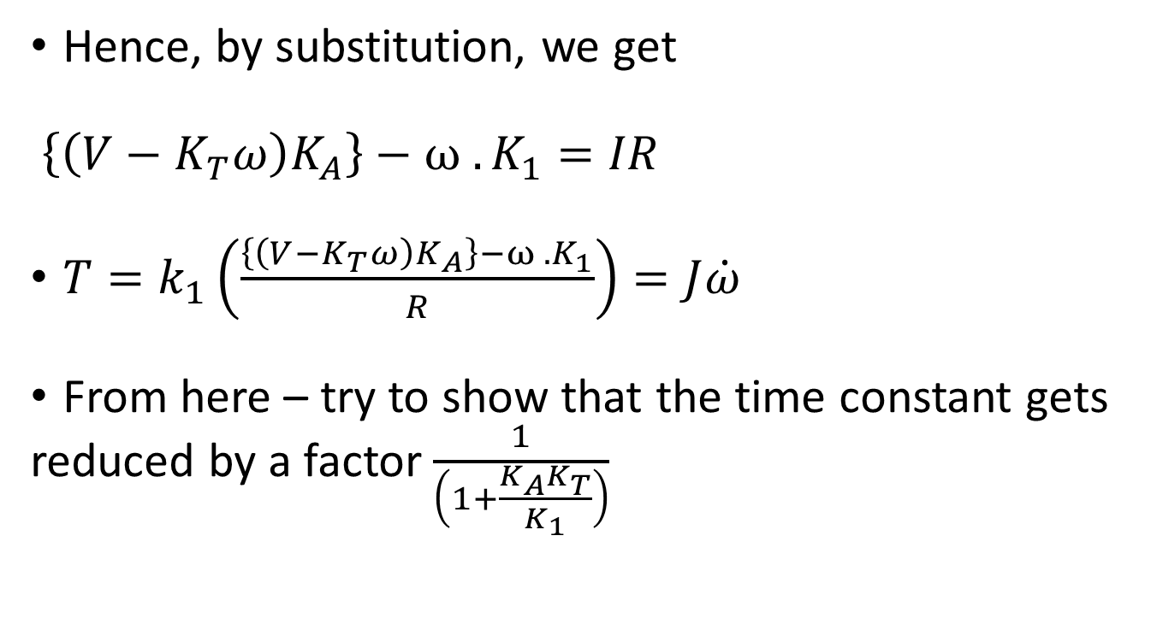
PMDC motor – cotd.
Hence, by substitution, we get
$\left\{\left(V−K_{T}ω\right)K_{A}\right\}−{ω .K}_{1}=IR$
$T=k_{1}\left(\frac{\left\{\left(V−K_{T}ω\right)K_{A}\right\}−{ω .K}_{1}}{R}\right)=J\dot{ω}$
From here – try to show that the time constant gets reduced by a factor $\frac{1}{\left(1+\frac{K_{A}K_{T}}{K_{1}}\right)}$

Slide 145
MCQ
Tachogenerator (A Permanent magnet DC motor run as a generator) voltage output is always
a. Constant b. Dependent on its shaft RPM
c. Sinusoidal d. None of the others

Slide 146
Quickening response by high T/J
Employing a low diameter elongated shape for motor so that the ratio of T/J will be increased

Slide 147


Printed circuit motors – to reduce T/J
Increase the radius of the armature
– higher T ☺ but higher J as well ☹
Use Aluminum wires instead of Copper
Remove soft iron core
Use strong transverse magnetic field
Instead of radial field
Use thin plastic armature with
Al-wires stamped on it like PCB
Apart from printed circuit motors, small diameter elongated shapes of motors will also yield high T/J
N
S

Slide 148
Encoders
Till now – we have only looked at incremental encoders
These encoders cannot provide information about the direction of rotation.
They only provide information about magnitude of distances covered in incremental mode and magnitude of velocity.
Direction sensing encoders can sense the direction in which the encoder is rotating
Absolute encoders can sense direction as well as absolute position with respect to origin

Slide 149
Encoders for feedback
Rotary encoders have a problem – they are mounted on the lead screw and hence, they cannot detect errors in motion beyond the lead screw.
Backlash present between lead screw and nut and therefore go undetected by encoder.
Backlash, if present, will also affect profile accuracy in continuous control. Hence it HAS to be eliminated.
Recirculating ball screw nut mechanism can remove backlash

Slide 150












Slide 151
☺ And ☹
It helps in reducing sticking friction by replacing sliding motion by rolling motion ☺
Wear and tear is reduced ☺
Backlash is eliminated if slightly oversize balls with pre-loading is used. ☺
The unit is not self-locking ☹
Lateral dimensions increase ☹

Slide 152
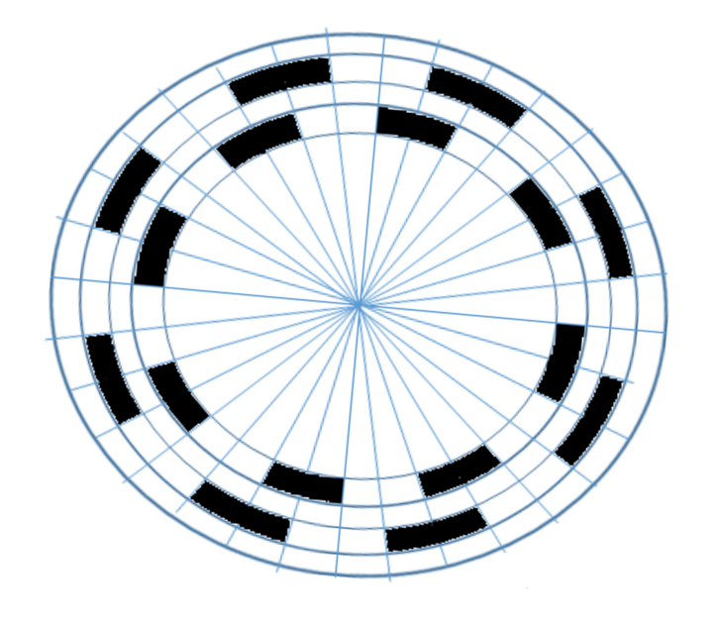
Direction sensing encoder – senses direction and changes channel
CW Y
CW
CCW
Y
X
Convert the pulses into spikes – Malvino
Try out the circuits x.y and x.y’
X
Binary circuit
Y

Slide 153
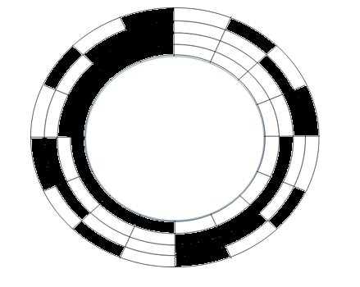

Absolute encoder – popular in robot movements – but can have counting errors

Slide 154
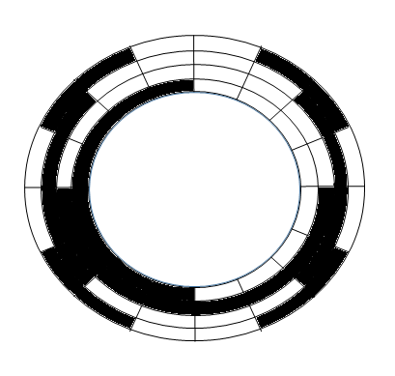
Grey coded disc –never two simultaneous changes

Slide 155
CNC programming : Computer numerical control programming 10th lecture
When a computer program, on being executed, successfully guides a machine tool through the sequence of motions and actions necessary for machining a part, or simulates such motions and actions on a graphic user interface, it is an example of computer numerical control programming or simply CNC programming.

Slide 156
G & M code programming
G & M Code programming language is a coded language to intimate to the machine
The type of motion to be executed
The auxiliary operations to undertake
through codes essentially preceded by G (preparatory function) or M (Miscellaneous function). Apart from such codes, parametric functions ( E parametres) and three letter codes are also admissible.
The G codes prepare the machine controls for the type of machine movements which are going to take place.
M codes provide instructions to the machine about the auxiliary or non-cutting operations (like tool change, spindle start, coolant on etc.). They are sometimes referred to as managerial or auxiliary commands.

Slide 157
Types of programmed motions
There are 4 basic types of motion for CNC machines.
The rapid traverse motion
the linear motion (at controlled feedrate)
the circular clockwise motion (at controlled feedrate)
the circular counterclockwise motion (at controlled feedrate)

Slide 158
Description of the basic G codes for motion
Code | Explanation | Format
G 00 | Rapid traverse | G00 X 200 Y300 Z 400
G 01 | Linear motion at controlled feed | G01 X 220 Y 320 Z440 F 200
G 02 | Circular clockwise motion | G02 X 250 Y 350 R 150 F200 or G02 X 250 Y 350 CX 270 CY 370 F200
G 03 | Circular counter clockwise motion | G03 X 300 Y 370 R 130 F 200 or G02 X 250 Y 350 CX 270 CY 370 F200

Slide 159
Example of typical command blocks
N006 G90 G00 X20 Y30
N007 Y50
N008 G01 X100 Y100 F200
N009 G02 X140 R200
N010 M30
Y
(100,100)
(140,100)
(20,50)
(20,30)
X

Slide 160
Program – starting declarations
Program may start with a number of declarations
Whether we want an incremental or absolute system of reference
Whether a number of options, if previously activated, are to be cancelled
Whether there is a declaration on the type of coordinate system or offset from such a coordinate system
Whether there is any declaration on tool / cutter and its length and diameter offsets
N001 G90 G40 G49 G80 G53 X0 Y0 ZO;
N002 M6 T12;
N003 G0 G90 G56 X-10 Y-10;
N004 M3 S2000;
N005 G43 H12 Z50;

Slide 161
Program structure – main program
The main body of the program may contain the various movements required
Alternatively – it may contain calls to subroutines which in their turn – contain various motion commands
A typical program may have a structure as follows

Slide 162
Mirror Imaging
Linear interpolation
Circular interpolation
Tool length offset
Tool diameter offset
Subroutine call
Canned drilling cycle
Repeat loop
Cutter diameter compensation
Cycle cancellation

Slide 163
Example of P-T-P programming
120⁰
In this example : there are 3 holes to be drilled at intervals of 120 degrees. The holes are centred around a point at (20,30) and at a radius of 32 mm. The first hole is making an angle of 50 degrees with the positive X axis.
This machining exercise can be done on the conventional drilling machine manually, if the points are marked or an indexing head or a rotary table is available. That means, operator skill / use of physical devices. In case of dividing head – we are rotating the physical object.
In case of the CNC machine, we would be rotating the coordinate system instead of the physical object. That’s quite smart – because the part would not have to be moved and the physical devices are not required any more.
PCR32
50⁰
(20,30)
120⁰
3 holes , Ø 5

Slide 164
PTP programming – contd…
120⁰
N01 T1.2 M06 S400 F50 M03
N02 E30=20
N03 E31=30
N04 E32=32
N05 E33=50
N06 E34=120
N07 E1=3
N08 E36=3
PCR32
N09 E37=-10
N10 E2=81
N11 CLS(SUB200)
N12 G Z20 M05
N200 (UOT,0,XE30,YE31)
N201 (RPT,E1)
N202 (URT,E33)
N203 GE2 RE36 Z E37
N204 XE32 Y
N205 E33=E33+E34
N206 G80
N207 ERP
N208 (UAO,0)
N209 (URT, 0)
50⁰
(20,30)
120⁰
3 holes , Ø 5

Slide 165
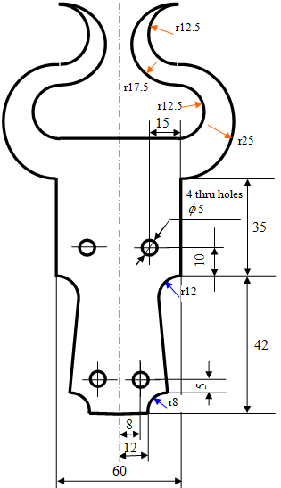
Example programs
Mirror Imaging
Linear interpolation
Circular interpolation
Tool length offset
Tool diameter offset
Subroutine call
Canned drilling cycle
Repeat loop
Cutter compensation
Cycle cancellation

Slide 166
Program
Milling subroutine
N02 M03 S1200 F500;
N03 G42 D03 G00 X0 Y0;
N04 Z -2.0;
N05 G01 X12 Y0;
N06 G02 X20 Y8 R8;
N07 G01 X18 Y30;
N08 G02 X30 Y42 R12;
N09 G01 X30 Y77;
N10 G03 X30 Y127 R25;
N11 G02 X30 Y152 R12.5;
N12 G03 X30 Y117 R17.5;
N13 G02 X30 Y92 R12.5;
N14 G01 X0 Y92;
N15 G01 Z30;
N16 G40 Y-12;
N17 M05;
N18 M99;
Drilling Subroutine: (P0038)
N50 G90 G40 G49 G80 G53 X0 Y0 Z0;
N51 M06 T04;
N52 M03 S1500;
N53 G56 G0 G90 X0 Y0;
N54 G43 H04 Z20;
N55 G81 G99 X8 Y13 Z-3.5 R15 F100;
N56 X-8 Y13;
N57 X-15 Y52;
N58 X15 Y52;
N59 G0 Z30;
N60 G0 X0 Y0;
N61 M05;
N62 M99;
Main Programme: (P0036)
N100 G90 G0 G40 G49 G80 G53 X0 Y0 Z0;
N101 T12 M6;
N102 G90 G56 G17 X0 Y-10;
N103 G43 H12 Z50;
N104 M98 P0037;
N105 G51.1 X0;
N106 M98 P0037;
N107 G0 Z30;
N108 G50.1 X0;
N109 M98 P0038;
N110 M05;
N111 M02;
N112 M30;

Slide 167
Display Z = -Z3
Spindle
Z1
This
gap is Z3
Z2 is the job height

Slide 169
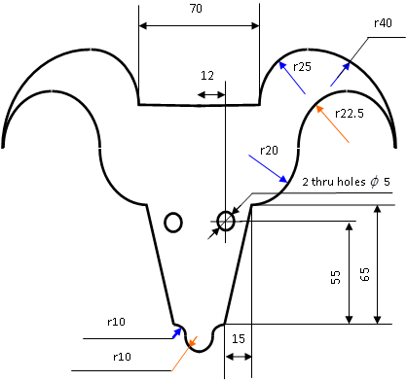

Slide 170
Program start
Call Milling
Mirror imaging
Call Milling
Cancel Mirror
Call drilling
Milling subroutine
Drilling subroutine

Slide 171
G00 – Rapid traverse
G01 – Linear
G02 – Circular CW
G03 – Circular CCW
G20 – Cancel GTL
G21 – Enable GTL
G40 – Cancel cutter radius compensation
G41 – Cutter radius compensation left
G42 – Cutter radius compensation right
G81 – Canned drilling cycle
G90 – absolute programming
G91 – Incremental programming
M00 – program pause
M03 – Spindle on
M05 – Spindle off
M06 – Tool change
M08 – Coolant on
M09 – Coolant off
CLS – call subroutine
RPT – Repeat
URT – rotate coordinate system
UOT – use temporary origin
UAO – Use absolute origin
ERP – End of Repeat

Slide 172
Programming practice - II
11th Lecture in the open online course “Computer Numerical Control (CNC) of Machine Tools and Processes

Slide 173
Example programs
Mirror Imaging
Linear interpolation
Circular interpolation
Tool length offset
Tool diameter offset
Subroutine call
Canned drilling cycle
Cutter compensation
Cycle cancellation

Slide 174
Program structure
Program start
Call Milling
Mirror imaging
Call Milling
Cancel Mirror
Call drilling
Milling subroutine
Drilling subroutine

Slide 175
Program
Milling subroutine (P0037)
N01 G90 G0 G40 G49 G80 G53;
N02 M03 S1200 F500;
N03 G42 D03 G00 X0 Y0;
N04 Z -2.0;
N05 G01 X12 Y0;
N06 G02 X20 Y8 R8;
N07 G01 X18 Y30;
N08 G02 X30 Y42 R12;
N09 G01 X30 Y77;
N10 G03 X30 Y127 R25;
N11 G02 X30 Y152 R12.5;
N12 G03 X30 Y117 R17.5;
N13 G02 X30 Y92 R12.5;
N14 G01 X0 Y92;
N15 G01 Z30;
N16 G40 Y-12;
N17 M05;
N18 M99;
Drilling Subroutine: (P0038)
N50 G90 G40 G49 G80 G53 X0 Y0 Z0;
N51 M06 T04;
N52 M03 S1500;
N53 G56 G0 G90 X0 Y0;
N54 G43 H04 Z20;
N55 G81 G99 X8 Y13 Z-3.5 R15 F100;
N56 X-8 Y13;
N57 X-15 Y52;
N58 X15 Y52;
N59 G0 Z30;
N60 G0 X0 Y0;
N61 M05;
N62 M99;
Main Programme: (P0039)
N100 G90 G0 G40 G49 G80 G53 X0 Y0 Z0;
N101 T12 M6;
N102 G90 G56 G17 X0 Y-10;
N103 G43 H12 Z50;
N104 M98 P0037;
N105 G51.1 X0;
N106 M98 P0037;
N107 G0 Z30;
N108 M98 P0038;
N109 M05;
N110 M02;
N111 M30;
Assistance in programming and machining from staff and students of mechanical training workshop, IIT Kharagpur is sincerely acknowledged

Slide 176
CNC lathe programming
R30
M12 × 1
X +ve
Ø 35
Ø 16
Ø 22
Z +ve
8
15
10
4
16
2×45⁰

Slide 177
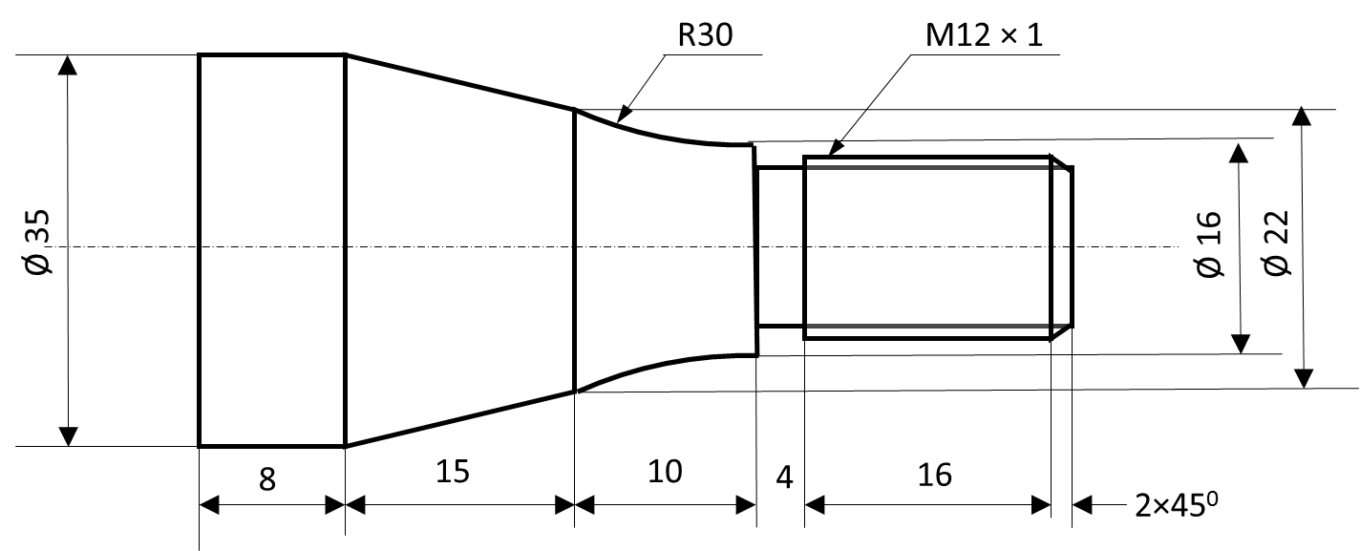
Tool turret on this side
X +ve
Z +ve
N1 (Roughing of OD) ;
G50 S2000; (Spindle max speed setting)
G00 T0101 M42; (Turret station number and tool offset, Spindle speed high)
G96 S120 M04; (Constant surface speed cmd, spindle CCW)
G00 X 38.0 Z 1.0; Rapid traverse to X,Z
G71 U1.0; (roughing of OD, depth of cut 1 mm)
G71 P1000 Q1100 U1.0 W0.1 F0.1; (starting block, ending block, finishing allowance in X, finishing allowance in Z, roughing feed)

Slide 178
Tool turret on this side
X +ve
Z +ve
N1000 G00 X8.0;
G01 Z0;
X12.0 Z-2.0;
Z -22.0;
X16;
G02 X22 Z-32R30
G01 X35 Z-47;
Z-55;
N1100 X39;
G00 X200 Z100;
G42 G0 X200 Z100;
G70 P1000 Q1100 F0.05;
G40 G00 X200 100;
M05; Spindle Stop
M01; Optional stop
N3 (Threading)
G28 U0;
G28 W0;
G0 T0707 M41;
G97 S500 M04;
G0 X12.0 Z-20;
G92 X11.6 Z2.0 F1.0;
X11.4;
X11.2;
X11.0;
X10.9;
X10.8;
X10.7;
X10.7;
N2 (Grooving)
G28 U0; (Zero return)
G28 W0;
G50 S1500;
G0 T0202 M41 spindle speed low
G96 S70 M04 CCW Spindle rotation
G00 X20 ;
Z -22;
G01 X10.2 F0.05;
X39 F5;
X10.6;
X10.6;
X10.6;
G00 X200 Z100;
M05;
M01;

Slide 179
Tool turret on this side
X +ve
Z +ve
Reference : CNC lathe programming and machine operations training manual : LMW
N4 (Parting Off)
G28 U0;
G28 0;
G50 S2000;
G00 T0202 M42;
G96 S80 M04;
G00 X39;
Z-59;
G01 X-1 F0.05;
X39 F5;
G0 X100;
Z200;
M05;
M30;

Slide 180
G00 – Rapid traverse
G01 – Linear
G02 – Circular CW
G03 – Circular CCW
G20 – Cancel GTL
G21 – Enable GTL
G40 – Cancel cutter radius compensation
G41 – Cutter radius compensation left
G42 – Cutter radius compensation right
G81 – Canned drilling cycle
G90 – absolute programming
G91 – Incremental programming
M00 – program pause
M03 – Spindle on
M05 – Spindle off
M06 – Tool change
M08 – Coolant on
M09 – Coolant off
CLS – call subroutine
RPT – Repeat
URT – rotate coordinate system
UOT – use temporary origin
UAO – Use absolute origin
ERP – End of Repeat

Slide 181
Computer aided offline programming
12th Lecture of the online course “Computer numerical control (CNC) of machine tools and processes”

Slide 182
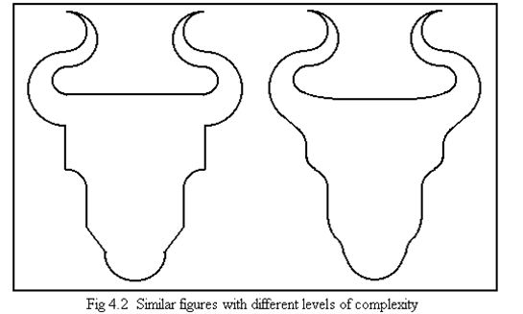
Similar figures with different levels of complexity

Slide 183
There are many packages existing for computer aided offline programming
Starting with APT (Automatically programmed tools), there have been ADAPT, EXAPT, FAPT, GTL etc.
A few examples will be discussed with respect to computer aided offline programming
These are meant to reduce the load of part geometry and cutter path calculations by the help of a computer program
The work of the programmer is to intimate the geometry information and cutter path details to the computer

Slide 184
General features
These softwares generally define coordinate systems, points, lines, circles, surfaces etc to define the geometry of a part
Then cutter paths are defined with respect to these geometry elements
G and M codes for the cutter paths are output after postprocessing
A line may be having a definition as simple as
l1 = X20Y30,X220Y330
This defines a straight line which is passing through the two points 20,30 and 220,330 and is directed from the first to the second point

Slide 185
o1 = X180 Y20 a30
l2 = X20 Y25, a60
l8
c1=x25y75,r-34
c5
r34
p4 = l2,c1,s2
l1 = p1, p2
(25,75)
p2 = X120 Y125
P12 = c1,c5
p3
p3 = l2,c1
p4 = o1 X20 Y20
60 degrees
p1 = X20 Y25
30 degrees
p3 = l1,l8
o1 = (180,20)

Slide 186
Some GTL definitions (If I am not audible – please phone 9434036694
c2 = m20 a50, r10
p1 = X… Y…
p2 = m… a…
p3 = l1, l2
p4 = [-]l3, cp [,s2]
p5 = c1, [-]l5 [,s2]
p6= c5, c6 [,s2]
p2 = m20 a50
m =20 mm
50 degrees

Slide 187
l3 = [om] I.. J.. r.., [op] I.. J.. R..
l4=I10J12r-50,a75
l2 = I10 J12 r-50, I25 J75 r-34
c5 = I 10 J 12 r50
c1=I25 J75 r-34
l3=I10J12r50,I25J75r-34
75 degrees with X axis
l1 = I10 J12 r50, I25 J75 r34
I cannot hear you so if you cannot see the slides or if you have hearing issues –
please phone me up 9434036694
l5 = I10J12r-50, a-105

Slide 188
l2
l1
c2=-l2, l1, r20

Slide 189
c2=-l1,-c1,r-10
C3=-c1, -l1, r-10
4
3
2
1
5
c1

Slide 190
p1
l1
c1 to be defined with radius 10 ccw

Slide 191
L1 = [om] X..Y.., [op]X.. Y..
L2 = [om] X.. Y.., a..
L3 = [om] I.. J.. r.., [op] I.. J.. R..
L4 = [om] I.. J.. r.., a..
L5 = [om] I.. J.. R.., X.. Y..
L6 = [om] X.. Y.., [om] I.. J.. r..

Slide 194
Discussion on definitions : Lines with direction, circles with sense of rotation….
As an example, in GTL software : A point may be defined by its coordinate values, by the intersection of two straight lines or two circles or one st line and one circle
A st line may be defined by two points, by one point and angle with positive X, by one point and (tangent to) one circle, by tangent to two circles, angle with positive X and touching a circle. Straight lines have a direction.
A circle may be defined as having a centre and a radius, two tangents and a radius, one tangent and touching another circle and radius. Circles have a sense of direction : CW or CCW.
Ref : 8600 MC Manual, LMW

Slide 195
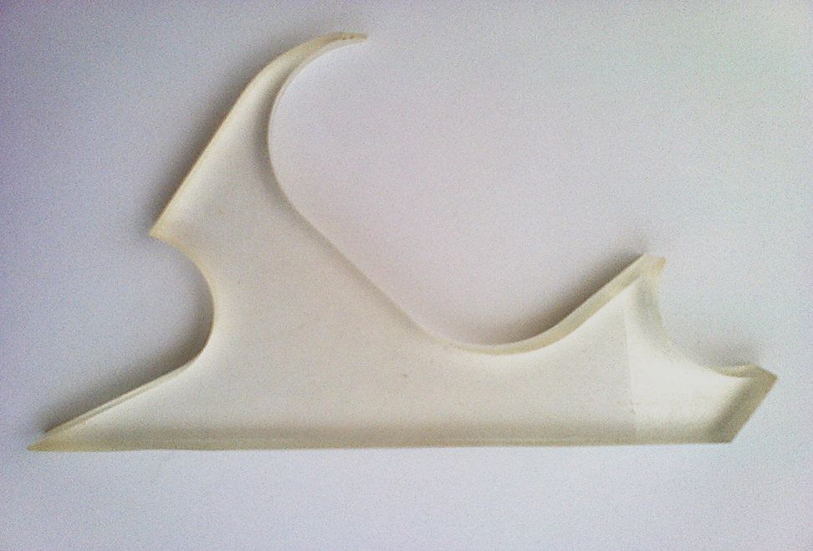
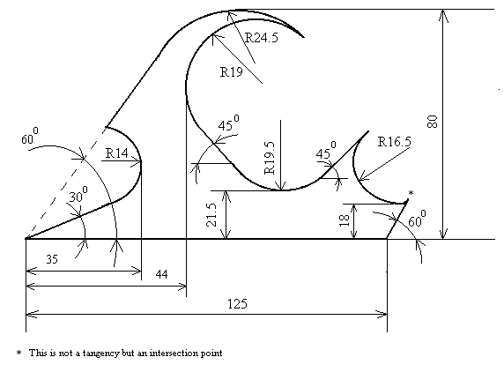
The drawing and the machined part

Slide 196
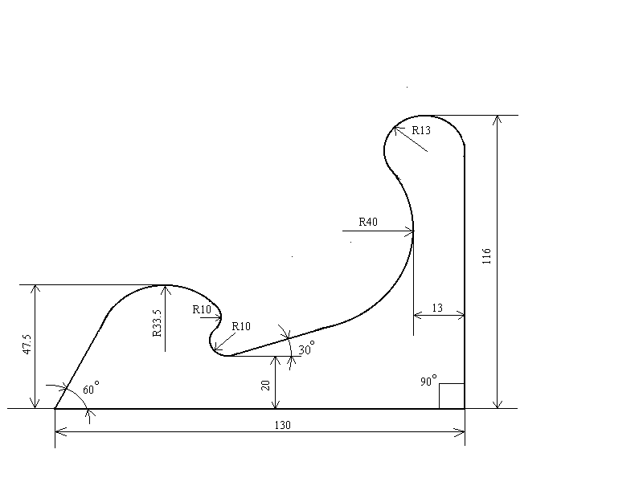
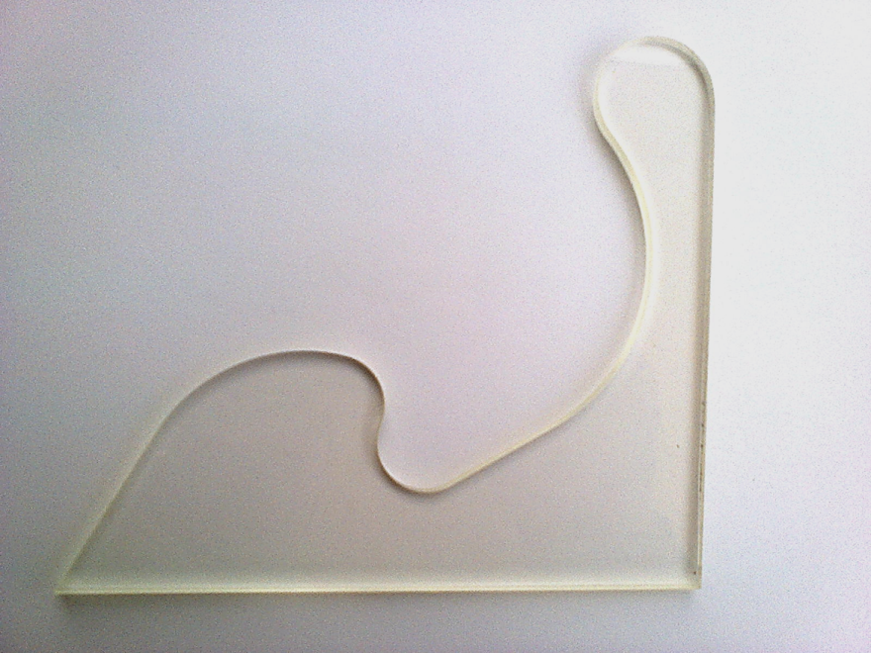
Another one

Slide 197
(0,0)

Slide 198
Feasibility test
Yes

Slide 200
Programming
Geometry definitions
l1=X0Y0,X100Y0
l2=X125Y,a60
l6=XY,a210
l11=X35Y0,a-90
c1=l11,l6,r-14
l5=XY,a-120
l10=XY80,X-100Y80
c2=l10,l5,r24.5
l9=X44Y0,a90
c3=l9,-c2,r-19
l4=c3,a135
c2
l10
l5
c3
c1
c5
l8
l3
l11
l4
c4
l6
l9
l7
l1
l2
l8=XY21.5,a180
c4=l8,l4,r-19.5
l3=c4,a-135
l7=X0Y18,a180
c5=l7,-l3,r-16.5

Slide 202
L1
L2
c2 = -l2, -l1, r25

Slide 203
Programming
Motion commands
T2.3 M6 S500 M3 F90
G21 G42 l6
l1
l2
r0
c5
r0
l3
c4
l4
c3
r0
c2
l5
r0
c1
l6
G20 G4 l1
G0 Z100 M5
M30
c2
l10
l5
c3
c1
l9
l3
l4
c5
l8
c4
l7
l2
l6
l11
l1
Reference : 8600 MC manual : LMW

Slide 204
How do these softwares work ?
All coordinate geometry calculations are embedded
Work piece geometry can be calculated from definitions
Cutter path locus can be calculated from offset calculations
In case of multiple possibilities – the modifiers are utilized to pinpoint the unique case – by if-then-else conditions

Slide 205
A further development
At present – the definitions of the geometries are given in a definite sequence
If geometry A is defined with respect to geometry B and geometry C, B and C would first have to be defined.
However, with proper programming, there would be no need to give the geometry definitions in any given sequence. The program can keep definitions of geometries in abeyance till all their required geometries are defined.

Slide 206
Interpolators - linear
13th lecture

Slide 207
A brief look at interpolators
Interpolators can be made by software or by hardware
Hardware interpolators may be made by a number of Digital differential analyzers (DDA) and have a software counterpart as reference pulse interpolator
Interpolation may not be restricted to linear and circular interpolation, but may involve parametric curve interpolation
Curve interpolators may be offline or online (real time)

Slide 208
Numerical problem 13.1

Slide 209
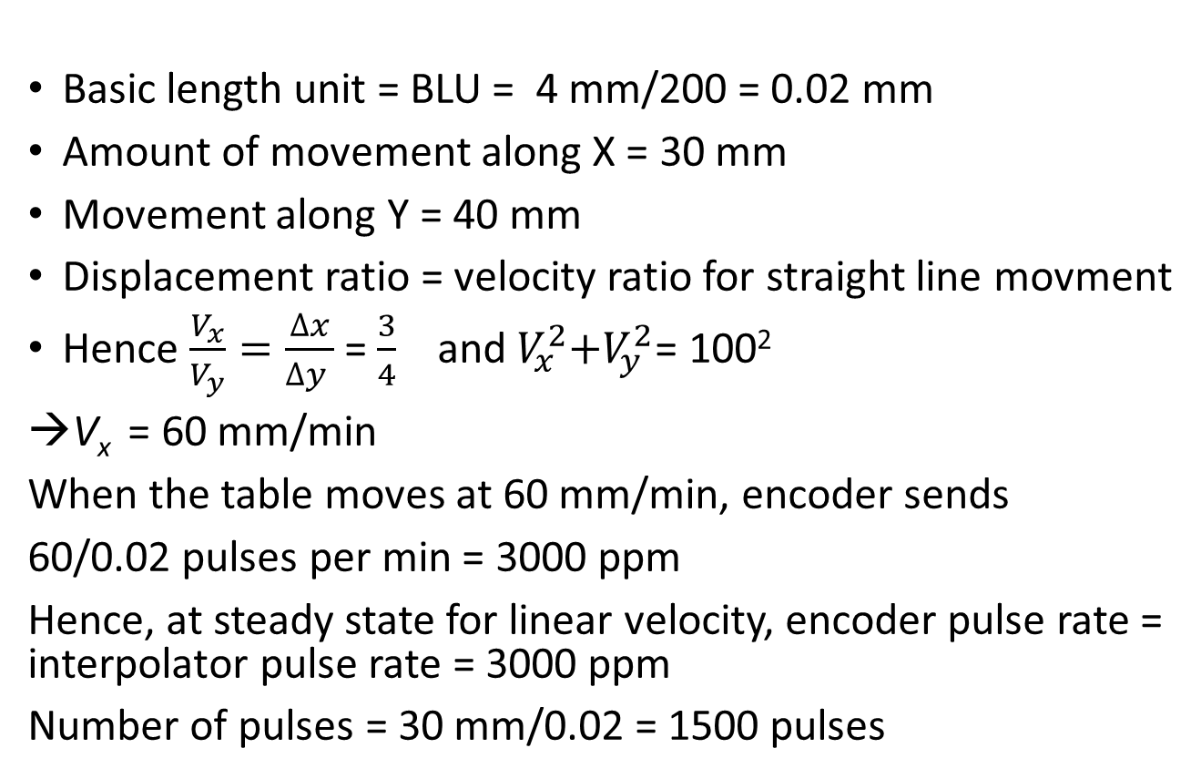
Answer to the problem
Basic length unit = BLU = 4 mm/200 = 0.02 mm
Amount of movement along X = 30 mm
Movement along Y = 40 mm
Displacement ratio = velocity ratio for straight line movment
Hence $\frac{V_{x}}{V_{y}}=\frac{∆x}{∆y }$ = $\frac{3}{4}$ and${ V}_{x}^{2}+V_{y}^{2}$= 100²
V_{x}= 60 mm/min
When the table moves at 60 mm/min, encoder sends
60/0.02 pulses per min = 3000 ppm
Hence, at steady state for linear velocity, encoder pulse rate = interpolator pulse rate = 3000 ppm
Number of pulses = 30 mm/0.02 = 1500 pulses

Slide 210

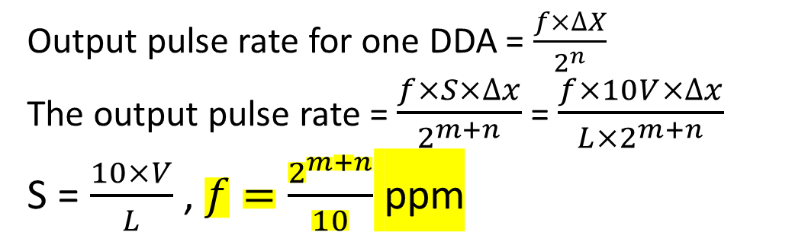
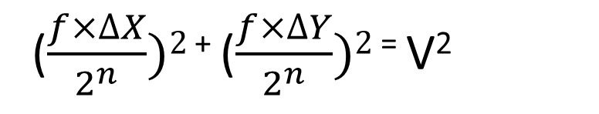
DDA-based interpolators (linear)
($\frac{f×∆X}{2^{n}})2$ ⁺ ($\frac{f×∆Y}{2^{n}})2$ ⁼ V²
X DDA
n bit
∆x
Feed DDA
m bit
S
f
Y DDA
n bit
∆y
Output pulse rate for one DDA = $\frac{f×∆X}{2^{n}}$
The output pulse rate = $\frac{f×S×∆x}{2^{m+n}}$ = $\frac{f×10V×∆x}{L×2^{m+n}}$
S = $\frac{10×V}{L}$ , $f=\frac{2^{m+n}}{10}$ ppm

Slide 211
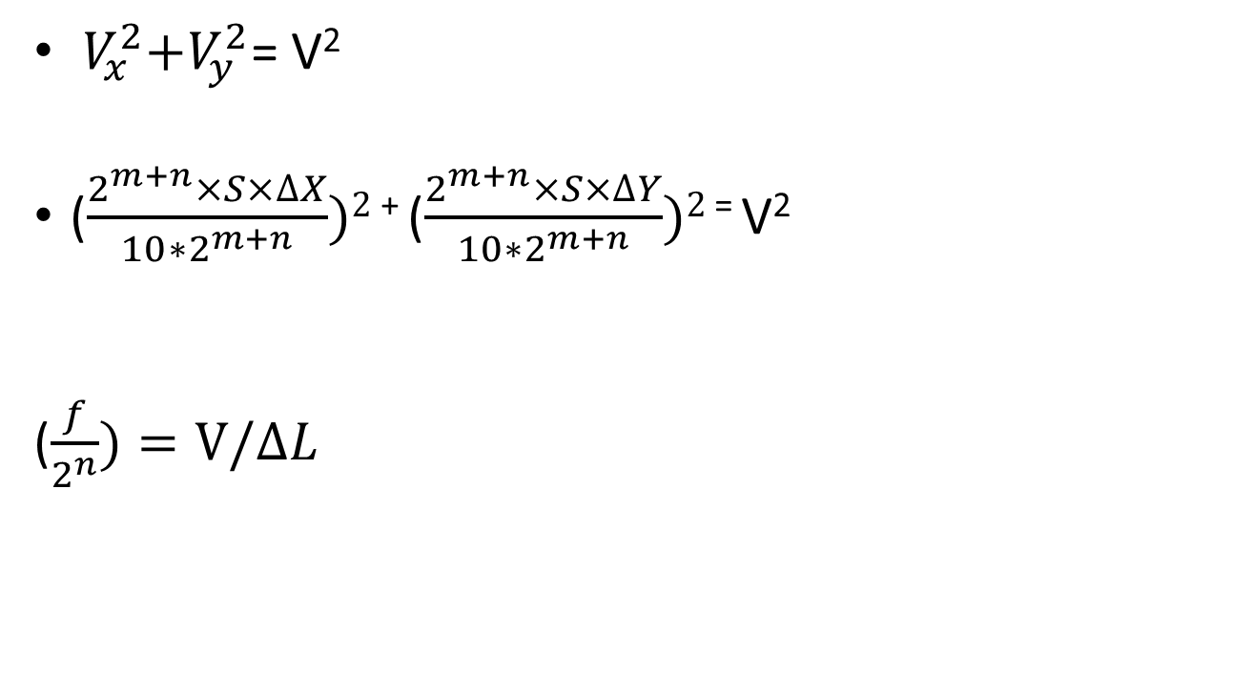
${ V}_{x}^{2}+V_{y}^{2}$= V²
($\frac{2^{m+n}×S×∆X}{10∗2^{m+n}})2$ ⁺ ($\frac{2^{m+n}×S×∆Y}{10∗2^{m+n}})2$ ⁼ V²
($\frac{f}{2^{n}})=V/∆L$
ΔL

Slide 212
Numerical problem
During DDA based linear interpolation, the cutting tool centre has to move from point P(20,10) to point Q(120,60) at a speed of 3 m/min. The coordinates of the points are in mm. The table size is 600 mm × 600 mm. The maximum movements along the axes are equal to the maximum dimensions along those axes. The maximum table speed is 12 m/min for a minimum distance of 50 mm. BLU = 10 micron along each axis. Determine
Bit size of all three DDAs
The S word in the Feed DDA
Values of px and py
Clock frequency
Output frequency of Feed DDA
Output frequency of x and y axis DDA.

Slide 213
If the maximum motion is 600 along any one axis and the BLU is 10 microns, the size of DDA should be n=16, ie 65536 (p_{x} and p_{y} would be max 60,000) Maximum feed rate number corresponds to max (10V/L) where V is in length units /min and L is in same length units
Highest velocity = 12 m/min and lowest distance for which this can be implemented is 50 mm
So, Max S word = 10 * 1200000/(5000) = 2400
Therefore m = 12 in order to accommodate the max S word If m and n are known, f = 2^{m+n}/10 = 2¹²⁺¹⁶/10 ppm
= 447,392 pps

Slide 214
For the particular case given
Incremental x and incremental y in BLU = 10000 and 5000 in binary
L = length of cut = √(10000² + 5000²) = 11180 in BLU
Output freq of Feed DDA for this movement is
= f * S/2^{m} = f * (10*V/L) /2¹² = 447,392 * (10*300000/11180)/ 2¹²
= 29309.43 pps
Output frequency of x and y DDA would be
= 29309.43 * 10000/2¹⁶ = 4472 pps = V_{x}
29309.43 * 5000/2¹⁶ = 2236 pps = V_{y}
Verify vector sum of V_{x} and V_{y} = 3 m/min
How ? Well V_{x} = 4472 BLU/s = 44.72 mm/s = 2683 mm/min
V_{y} = 2236 pps = 22.36 mm/s = 1341.5 mm/min
Check out their vector sum -- is it 3 m/min ???

Slide 215
MCQ
You join DRDO and they ask you to design a grenade with programmable delay before detonation. Inside the grenade, there is to be a chip with a fixed clock at 1024 pps which is input to a DDA and the first overflow of the DDA will cause detonation. The grenade will have buttons to load the counter of the DDA with 3 numbers for 3 detonation delay times: 2 seconds, 4 seconds and 8 seconds. What should be the minimum DDA size to make this work?
2¹⁰ – 1 b. 2¹³ – 1
c . 2¹⁸ – 1 d. None of the others

Slide 216
Ans
The rates of detonation are
½ per second, ¼ per second and 1/8 per second
Assuming that the number of bits in DDA to be x
The lowest output pulse rate is = 1024 X 1 /(2^{x}) = 1/8

Slide 217
Numerical problem
You join a company which makes escalators. The prime mover is a stepper motor which gets pulses from a Digital differential analyser (DDA) which has X = 13 and n = 5. The DDA is run by a pulse train of frequency f. One customer wants you to reduce the speed of the escalator to 13/32 of its present speed. How will you do it ? No gearbox allowed.

Slide 218
Question for you …
There are two motors in an experimental set-up which should always have their speeds in the ratio 3:5. How can this be done by the use of DDAs ?

Slide 219
Find the x and y components of the velocity
Vy = RωCosωt
V = Rω
R
Vx = RωSinωt
dI/dt = -RωSinωt
J=RSinωt
dj/dt = RωCosωt
θ
I = RCosωt

Slide 220
We may write (f*S/2^{m})*(Rsinωt/2^{n}) = V_{x} and (f*S/2^{m})*(Rcosωt/2^{n}) = V_{y}
X DDA
n bit
R×sinωt
+
Feed DDA
m bit
S
f
Y DDA
n bit
R×cosωt
-
Ref: Computer Control of Manufacturing Systems by Yoram Koren, Tata-McGraw-Hill

Slide 221
For circular interpolation
For circular interpolation, the feed DDA “S” word changes to 10 V/R
The contents of the registers in the X and Y DDAs are
R sin ωt and R cos ωt
There is feedback.

Slide 222
Curvilinear interpolators
The interpolators that we have been discussing are hardware interpolators. There are software interpolators also. Some of these are simply ‘software translations’ of the hardware Interpolators while others work on different principles.
CNC reference pulse interpolators
The most common interpolator of this kind is simply a soft version of the hardware interpolator that you have studied. However, the problems of the hardware interpolator are identified and removed. For example – the hardware interpolator has its DDA sizes fixed and this comes from the consideration of worst cases – so that very high values of system clock frequencies are required.
Instead of simply achieving linear and circular interpolation, software interpolators can be employed for finding out points on parametric curves.
Such Software interpolators can be ‘offline’ or ‘online’ as per system requirement.

Slide 223
Offline Curve interpolators
In case of the offline software interpolator, the points on the curve of movement are selected through the application of some criterion : for example :
The deviation of the actual path of the cutter (generally straight) from the curve should be same for all segments of motion.
This gives rise to a number of segments of motion which are not necessarily same in length.
If the same velocity is employed (which is expected, in order to obtain the same feed value along the path for obtaining the same surface roughness), we cannot simply cut these unequal segments in integral machine cycle durations.
Hence, in order to cut these unequal segments in integral values of machine cycle times, we employ different values of feed in different segments. This is called federate fluctuation.

Slide 224
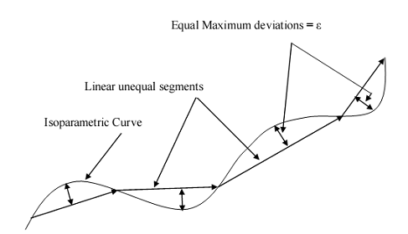
Offline interpolators contd…

Slide 225
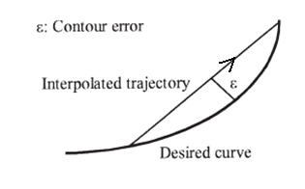
Offline vs Online
Feed rate fluctuation
Contour error
Memory size and data transfer

Slide 226
Online software curve interpolator
In case of the software online interpolator, the case is a bit different. As you can put in as many points as you like (since you are not loaded with the problem of uploading points to the machine) – the machine does not have the imposition of any condition like form tolerance maintenance etc. Hence, the issue of accuracy of the cut path is taken care of by the huge number of points that you can put in by online calculations. The only problem in this type of interpolators is that – the routine that calculates the next point should be simple and fast so that the next point can be found out in real time.

Slide 227

On line interpolator

Slide 228
Questions on programming and interpolation
15th Lecture in the open online course “Computer numerical control (CNC) of machine tools and processes”

Slide 229
MCQ 1
One of the main functions of the CNC interpolator is to
Maintain programmed ratios between axes speeds
Start the spindle rotation
Interpolate between two spindle speeds
None of the others

Slide 230
A prospective customer of a CNC P-T-P table wants X-axis BLU to be halved and X-axis table speed to be doubled. The X-axis employs: Pulse generator-stepper motor (200 steps per revolution, 1 steps per pulse) – gearbox (ratio ½ ) – lead screw (pitch 4 mm). One solution is to
Simply add a DDA with n = 2 and X = 2 in between pulse generator and motor
Remove gear box
Quadruple pulse generator frequency and add a DDA with n=2 and X=2
None of the others

Slide 231
If there is a DDA, its output = $\frac{f×X}{2^{n}}$
Previous BLU =0.01 mm and previous velocity = 0.01$×f$
Hence requirement is BLU =0.005 mm and velocity = 0.02$×f$
Let us take the first case (which is in any case impossible as pulse frequency is brought down)
BLU = distance per pulse from pulse generator = $\frac{f×2}{2^{2}}×\frac{1}{200}×\frac{1}{2}×\frac{4}{f}=\frac{1}{200}$ =0.005 mm → correct
X-axis table speed = $\frac{f×2}{2^{2}}×\frac{1}{200}×\frac{1}{2}×4=$0.005$×f$→ incorrect
2nd case (which is in any case impossible as BLU is bound to rise)
BLU = $f×\frac{1}{200}×\frac{4}{f}=\frac{4}{200}$ =0.02 mm → incorrect
X-axis table speed = $f×\frac{1}{200}×4=$0.02$×f$→ correct

Slide 232
MCQ contd…
3rd case
BLU =$4f×\frac{2}{2^{2}}×\frac{1}{200}×\frac{1}{2}×\frac{4}{4f}=\frac{1}{200}$ =0.005 mm → correct
X-axis table speed $=$0.005$×4f=0.02×f$→ correct

Slide 233
A stepper motor of 200 steps per revolution was connected via a ¼ ratio gearbox to a leadscrew of 5 mm pitch.
The basic length unit (BLU) is
a. 5 microns b. 2 microns c. 6.25 microns d. None of these
2. The steps are counted down in a position down counter (PDC) as shown in Fig. It is desired by a customer that each bit of the counter represent 10 microns. This can be done by attaching a DDA as shown with
a. n = 8 and X = 5 b. n = 2 and X = 3 c. n = 3 and X = 5 d. None of these

Slide 234
BLU =(1/200)×(1/4)×5 = 0.00625 mm
By the time 8 pulses are sent to the motor to give 8 × 0.00625 = 0.05
If you send 5 pulses to the PDC – it will show decrements of 5 bits. Hence these bits would represent 50 microns so 1 bit would represent 10 microns.
Use a DDA with n = 3 and X = 5

Slide 235
The feed (mm/min) along X axis corresponding to the program line G91G01X40Y30F50 is
40 b. 50
c. 30 d.None of the others
(G91 – incremental)

Slide 236
If drilling is done on a CNC machine with contouring control system
The “cutter diameter compensation left” should be used
The “cutter diameter compensation right” should be used
Drilling cannot be done on CNC machines with contouring control system
Cutter diameter compensation is not required
None of the others

Slide 237
Cutter radius compensation in CNC 2-D milling with end milling cutter is used to
Determine radial run-out of cutters
Determine the cutter RPM
Find cutter center locus from work piece geometry and cutter diameter
None of the others

Slide 238
A CNC milling machine is having maximum X – travel to be 1000 mm. If the basic length unit along X axis is 0.001 mm, the least size of the X-DDA would be
20 bits (b) None of the others
(c ) 10 bits (d) 16 bits

Slide 239
For execution of line no. 2,
Line 1 G90 G00 X00.55 Y 20.30
Line 2 G01 X12.55 Y25.30 F200
The ratio of V_{x}/V_{y} is
12/5 b. 144/25 c. 13/12
d. None of the others

Slide 240
A Digital differential analyzer (DDA) is to emit c = 3000 ppm. If the input pulse frequency f is 6000 ppm, n = 4, the content X inside the DDA (which gets added repeatedly) is

Slide 241
Mirror imaging in a CNC program
Cannot be performed in case of P-T-P machines
Cannot be performed in case of Continuous control machines
Can be performed in both the above types of machines
Cannot be performed in both

Slide 242
For the following part with the direction of motion shown, we would use
A. Cutter radius compensation left
B. Cutter compensation right

Slide 243
If l1 and c1 are already defined, the definition of the small circle c2 (radius 10 mm) would be (in GTL)
c2=l1, c1, r-10
c2=c1, -l1, r10
C2=-l1,c2,r10
None of the others
l1
c2
c1

Slide 244
3-D Machining – Basic concepts
16th Lecture in the course “Computer numerical control (CNC) of machine tools and processes”

Slide 245
Requirement of 3-D machining
Complex shapes and surfaces
Impression Die surfaces
Turbine, propeller blades
Aerofoils
Medical implants
Statues
Artistic objects

Slide 246

Car body production
Die material
Die material

Slide 247


EDM of Die surface
Graphite / Copper electrode
Machining of Electrode
Die material
Graphite / brass

Slide 248
Free form surfaces or sculptured surfaces
Free form surfaces or Sculptured surfaces or are those which do not possess any definite form and may be defined by the interpolation or blending of several coordinate points in space.

Slide 249



Free form surfaces can be modelled by Bezier surfaces, B-splines, NURBS (non-uniform rational B-splines) etc.
Z
Y
X

Slide 250

Cutter location points for machining a surfaces

Slide 251
Salient features of free form surface machining
The cutter – The cutter is generally selected as a ball end milling cutter as it can effectively machine concave profiles (crevices)

Slide 252

5-axis machining

Slide 253
Cutting of re-entrant sides

Slide 254

The cutter paths – The cutter paths are not continuous but made of small straight line segments called forward steps.
If the cutter paths are from one end to the other – they are separated by the side step or tool path interval.

Slide 255

Cutter path nomenclature

Slide 256
Ball ended milling cutter shown cutting a free form surface in
Zig-Zag cutting mode, taking blue forward steps and orange side steps

Slide 257
Forward steps and side steps
Length of forward steps is restricted by form tolerance
Length of side steps or tool path interval is restricted by surface roughness
Different cutter path generation strategies employ different criteria for selection of forward steps and side steps
Based on such criteria, Isoparametric, Isoplanar and Isoscallop methods of cutter path generation have evolved

Slide 258
Normals and tangents
1 normal at a point
Infinite tangents at a point
Tangents all perpendicular to the normal
Tangents all lying on the same plane
Normal obtained by cross product of any two tangents
Normal at a point is not necessarily vertical, it is simply normal to the tangent plane

Slide 259
Normals and tangents
When cutter touches a point on the surface, the normal through that point passes through the cutter centre

Slide 260

CC (cutter contact) points and CL (cutter location) points

Slide 261
Why CL points are required

Slide 262
Forward steps and deviation

Slide 263

Bezier curve
Where (0)⁰ ≡ 1 and 0! ≡ 1

Slide 264

Bezier surface

Slide 265

Bezier surface – control points

Slide 266
Curved surface geometry
17th Lecture in the open online course “Computer numerical control (CNC) of machine tools and processes”

Slide 267
Free form surfaces
There are different types of parametric surfaces employed for representing shapes.
Among these : Non-Uniform Rational B-splines (NURBS) are used to represent all surfaces and curves of CAD models.
In the present discussion, Bezier Surfaces will be discussed as they are similar in mathematical form to NURBS but easier for concept sharing.
Bezier splines, B-splines, Cubic-splines all belong to the family of spline curves.

Slide 268

Bezier curve nomenclature Bezier surfaces can be represented in a number of ways
$$P\left(u\right)=\sum_{i=0}^{n}{B_{i}×J_{n,i}(u)}$$
B₁
B₂
B₀, B₁, B₂, B₃ are control points
u → parameter varying along curve
0 ≤ u ≤ 1
B₀
Bezier curve
B₃
u= 0
u= 1

Slide 269

As a polynomial
$P\left(u\right)={\left(1−u\right)}^{3}×B_{0}+3×{\left(1−u\right)}^{2}×u×B_{1}$
$$+3×\left(1−u\right)×u^{2}×B_{2}+u^{3}×B_{3}$$
B₁
B₂
B₀
Bezier curve
B₃
u= 0
u= 1

Slide 270

As a matrix product
P$\left(u\right)$=$\left[U\right]×\left[X\right]×\left[B\right]$ [X] =$\left[\begin{aligned}1 0 0 0 \\ −3 3 0 0 \\ 3 −6 3 0 \\ −1 3−3 1 \end{aligned}\right]$
Where $\left[U\right]=\left[1 u u^{2} u^{3} \right]$
$\left[B\right]$ = control points matrix $=\left[\begin{matrix}\begin{matrix}\text{B}\text{0} \\ \text{B}\text{1}\end{matrix} \\ \begin{matrix}\text{B}\text{2} \\ \text{B}\text{3}\end{matrix}\end{matrix}\right]$
B₁
B₂
B₀
Bezier curve
B₃
u= 0
u= 1

Slide 271



Product of matrices form
$P(u)=\left[1 u u^{2} u^{3} \right]$×
×
$$\left[\begin{matrix}\begin{matrix}\text{B}\text{0} \\ \text{B}\text{1}\end{matrix} \\ \begin{matrix}\text{B}\text{2} \\ \text{B}\text{3}\end{matrix}\end{matrix}\right]$$
B₁
B₂
B₀
Bezier curve
B₃
u= 0
u= 1

Slide 272

Bezier surface as a matrix product
(1,1)
P$\left(u,w\right)$=$\left[U\right]×\left[X\right]×\left[B\right]×{\left[X\right]}^{T}×{[W] }^{T}$
Where $\left[U\right]=\left[1 u { u}^{2} u^{3} \right]$
$$\left[W\right]=\left[1 w { w}^{2} w^{3} \right]$$
This is for 4 × 4 control points
$\left[B\right]$= $\left[\begin{aligned}\begin{matrix}B_{11} & B_{12} & B_{13} \\ B_{21} & B_{22} & B_{23} \\ B_{31} & B_{32} & B_{33}\end{matrix} \begin{matrix}B_{14} \\ B_{24} \\ B_{34}\end{matrix} \\ \begin{matrix}B_{41} & B_{42}\end{matrix} \begin{matrix}B_{43} & B_{44}\end{matrix}\end{aligned}\right]$
(0,1)
Bezier surface in cartesian space
w
(1,0)
u
(0,0)
(0,1)
(1,1)
Surface in U-V plane
w
(0,0)
u
(1,0)

Slide 275
Data fitting for Bezier curve
The u_{i} values are found by chord length approximation

Slide 276

$\left[Data \right]$ = $\left[coefficients\right]×\left[control points\right]$
If no. of data points = no. of control points
The matrix can be inverted and the solved curve would pass through all the points
$\left[control points\right]$ = ${\left[coefficients\right]}^{−1}×\left[Data \right]$
If no. of data points ≠ no. of control points → matrix cannot be inverted - approximate (best fit) solution

Slide 277

Points to note for Bezier curves and surfaces
The highest power of the Bezier parametric equation $=n−1$
If number of control points is high – the degree of the Bezier polynomial is also high
If one control point for the Bezier surface is changed, it affects the shape of the whole surface. Effects cannot be localized.
If Bezier curve / surface is obtained by data fitting involving many data points but few control points, a perfect fit is not possible
However, matrix inversion is required only once

Slide 278

Tangents and normal
$n=P^{u}× P^{w}$
n
R^{w}
Isoparametric line u = k₁
(1,1)
R^{u}
(0,1)
w
(1,0)
u
(0,0)
Isoparametric line w = k₂

Slide 279

Finding tangents and normals
R$\left(u,w\right)$=$\left[U\right]×\left[X\right]×\left[B\right]×{\left[X\right]}^{T}×{[W] }^{T}$
R$\left(u,w\right)$=$\left[1 u { u}^{2} u^{3}\right]×\left[X\right]×\left[B\right]×{\left[X\right]}^{T}×{[W] }^{T}$
R^{u}$\left(u,w\right)$=$\left[U′\right]×\left[X\right]×\left[B\right]×{\left[X\right]}^{T}×{[W] }^{T}$
R^{u}$\left(u,w\right)$=[0 1 2u ${3u}^{2}$]$×\left[X\right]×\left[B\right]×{\left[X\right]}^{T}×{[W] }^{T}$
R^{w}$\left(u,w\right)$=[U]$×\left[X\right]×\left[B\right]×{\left[X\right]}^{T}×{[\text{0 1 2}\text{w} {3w}^{2}] }^{T}$

Slide 280
MCQ
If a vertical plane cuts a curved surface, the curve of intersection
Is always a straight line
Cannot be a planar curve
Has a tangent which is also tangent to the curved surface
None of the others

Slide 281

A curve R(t) on the surface R(u,w) and a tangent to it
(1,1)
R’(t)
(0,1)
R(t)
The curve is R(t) =
And the tangent to it is R’(t)
=$\frac{dR(u,w)}{dt}$ = $\frac{∂R}{∂u}×\frac{du}{dt}+\frac{∂R}{∂w}×\frac{dw}{dt}$
w
(1,0)
u
(0,0)
(0,1)
(1,1)
R(t)
t=1
w
t=0
(0,0)
u
(1,0)

Slide 282
Surface derivatives and curvature

Slide 283
Cutter path generation for curved surface geometry
18th Lecture in the open online course “Computer numerical control (CNC) of machine tools and processes”

Slide 284
Forward steps and deviation

Slide 285

The side step

Slide 286
Cutter Path Generation Approach
Isoparametric
Isoplanar
Isoscallop
The difference in the three strategies is the criteria of determining side-step

Slide 287
Different strategies of cutter path generation
Isoparametric method – Cutter paths are chosen as paths along which one of the parameters remains constant
Isoplanar method – Cutter paths are chosen along paths obtained as intersections of the surface with parallel vertical planes
Isoscallop method – Cutter paths are selected so as to obtain uniform surface roughness all over the surface

Slide 288

Isoparametric Approach
Cutter is made to move along isoparametric lines as cutter paths
Simple, non-iterative and computationally non-intensive
Drastic variation of surface roughness

Slide 289

Isoparametric cutter paths
u

Slide 290

Isoplanar Approach

Slide 291
Isoplanar cutter paths
cutter paths are obtained by the intersection lines between a free form surface and a number of parallel vertical planes
Surface roughness is not uniform
Parallel Vertical planes
w
u
Bezier surface
Cutter paths

Slide 292


Isoplanar forward steps
n
δ
R(u,w)
$$=R^{u}∆u+R^{w}∆w$$
dR.c = δ and dR.p = 0
eqns (1) & (2)

Slide 293
Forward step – contd…
eqns (3) & (4)

Slide 294
Steps in Isoplanar forward steps determination
Get a point on the edge of a surface R(u,w). This is the start point of a cutter path. This is the intersection point of the edge of the surface and the vertical plane that you have started with.
Define a guess value of δ to go to next point on the intersection curve. Generally this guess equals final δ of last forward step.
Apply SPI algo (surface plane intersection algorithm) to get the next point on the surface on the cutter path – that is, get ∆u and ∆w
Refine by CPI (curve plane intersection algo)
Once you get u1,w1 and u2,w2 – you can find the normals at the two points. Take their projections on the vertical intersecting plane.

Slide 295
6. Producing them backwards – get the radii at the two points. Get their mean = R
7. With the values of e (say 50 microns) and radius R find value of δ (from equations (3) and (4)). If the guess value of δ matches this value –select δ as path length. Go to 2. Else
8. Run SPI again with changed value of δ (that is – go to 3)
9. Continue

Slide 296
Cutter path generation (Concluding part) and Current status – CNC machining and related processes
19th Lecture in the open online course “Computer numerical control (CNC) of machine tools and processes”

Slide 297

Isoscallop Approach
Scallop height is kept constant which leads to uniform surface roughness
Requires less machining time
secondary cutter paths are derived from master cutter path
Redundant machining is minimized

Slide 298
Surface derivatives and curvature

Slide 299

Radius of curvature
R=$\frac{E{\left(\frac{du}{dt}\right)}^{2}+2F\left(\frac{du}{dt}\right).\left(\frac{dw}{dt}\right)+G{\left(\frac{dw}{dt}\right)}^{2}}{L{\left(\frac{du}{dt}\right)}^{2}+2M\left(\frac{du}{dt}\right).\left(\frac{dw}{dt}\right)+N{\left(\frac{dw}{dt}\right)}^{2}}$
$$=\frac{E{\left(\frac{du}{dw}\right)}^{2}+2F\left(\frac{du}{dw}\right) +G}{L{\left(\frac{du}{dw}\right)}^{2}+2M\left(\frac{du}{dw}\right)+N}$$

Slide 300


{(dR/dt).Δt /2}² = $R^{2}−{\left(R−e\right)}^{2}$ $I.\frac{{∆t}^{2}}{4}=2Re−e^{2}$
${\{R}^{u}∆u/∆t+R^{w}∆w/∆t$}. ${\{R}^{u}∆u/∆t+R^{w}∆w/∆t$}
R’(t) = R^{t}
R(t₁)
R(t₂)
R(t)
Use R^{t}
$$=R^{u}∆u/∆t+R^{w}∆w/∆t$$
∆t=t₂-t₁

Slide 301

K. Suresh, D.C.W. Yang, Constant scallop height machining of free form surfaces, Journal of Engineering for Industry, Transactions of ASME 17 (1994) 253–259
General equation of a tangent R(t) on a surface surface R(u,w) is
If there are two tangents at right angles to each other
$$\frac{dR}{dt}=\frac{dR(u,w)}{dt}=\frac{∂R}{∂u}.\frac{du}{dt}+\frac{∂R}{∂w}.\frac{dw}{dt}=R^{u}.\dot{u}+R^{w}.\dot{w}$$

Slide 302
K. Suresh, D.C.W. Yang, Constant scallop height machining of free form surfaces, Journal of Engineering for Industry, Transactions of ASME 17 (1994) 253–259

Slide 303
Centre distance = 2 × a = AB
D
A
B
Side step = ss = LM
X
r
Scallop height = h = XP
L
P
M
R
O

Slide 305


$$\frac{du^{∗}}{dw}≈\frac{Δu^{∗}}{Δw^{∗}}=α=−\frac{\left(F+G\frac{dw}{du}\right)}{\left(E+F\frac{dw}{du}\right)}$$
$$\left(R^{∗}−R\right)=SS= R^{u}∆u+R^{w}∆w$$

Slide 306
K. Suresh, D.C.W. Yang, Constant scallop height machining of free form surfaces, Journal of Engineering for Industry, Transactions of ASME 17 (1994) 253–259

Slide 307
Steps taken for getting the cutter paths

Slide 308
Steps taken for getting the cutter paths

Slide 309
Steps taken for getting the cutter paths

Slide 310
Steps taken for getting the cutter paths

Slide 311
Steps taken for getting the cutter paths

Slide 312
Steps taken for getting the cutter paths

Slide 313

Steps taken for getting the cutter paths

Slide 314


Steps taken for getting the cutter paths

Slide 315
Steps taken for getting the cutter paths

Slide 316
Steps taken for getting the cutter paths

Slide 317
Steps taken for getting the cutter paths

Slide 318

Steps taken for getting the cutter paths

Slide 319
Steps taken for getting the cutter paths

Slide 320
Steps taken for getting the cutter paths

Slide 321

A look at some of the free form machined shapes

Slide 322

Cotd. 2…

Slide 323

Cotd. 3 ….

Slide 324
20 Questions on curved surface machining
20th Lecture in the open online course “Computer numerical control (CNC) of machine tools and processes”

Slide 325
MCQ 1
Isoscallop machining is being carried out by a ball ended milling cutter machining a free form surface on a 3 axis CNC machine. In this case
Scallop heights are same all over whole surface
Scallop height between two cutter paths is always same but is different from that between two other cutter paths on the same surface.
Scallop height varies randomly.
None of the others

Slide 326
In 3-axis CNC machining of a free form surface employing ball end milling cutter, the criterion of determining the forward steps is
Uniform surface roughness (created by scallops)
Equal side steps orthogonal to cutter path
Tolerable deviation from surface form
None of the others

Slide 327
If there are 18 control points on a Bezier curve, the highest power of the parameter in the expression of the Bezier curve would be
19
18
17
3
None of the others

Slide 328
You make a matlab program for finding out the CL points for cutting a free form surface with ball end milling cutter (ball dia 5 mm) on 3-axis machining centre. You upload a G & M code program with the CL points to the machine but find that the cutter dia is actually 10 mm.
The form would not be accurate
No problem if you use this tool with this program – the surface finish is going to be better in fact
You declare 10 mm cutter dia in offset file and with G41 / G42, there will be no problem
CC data should have been used, not CL data

Slide 329
During CNC free form surface machining by ball end milling on 3-axis machine, the points on the free form surface contacted by the cutter
Are the points through which the center of the cutter is moved
Are the points through which the bottom-most point of the cutter is moved
Are called the cutter location points
None of the others

Slide 330
A free form surface is cut by a vertical plane. The normal to the surface at point x is not contained in the vertical plane. In such a case,
The intersection curve of plane and surface will not be contained in the plane
The normal p to plane will not be orthogonal to n
The center point of the ball ended cutter having cutter contact point at x would lie on the plane
None of the others

Slide 331
In the isoplanar method of cutter path generation, applied in case of free form surface machining in 3 axis machining centre with ball ended milling cutter, the cutter contact paths are the intersections of parallel vertical planes and the free form surface. Here,
The CL points for one particular cutter path are always contained in a vertical plane
The CC points for one particular cutter path are always contained in a vertical plane
Both the CC and CL points for one particular cutter path are always contained in a vertical plane
None of the others

Slide 332
In 3-axis CNC machining of a free form surface employing ball end milling cutter, the criterion of determining the forward steps is
Uniform surface roughness (created by scallops)
Equal side steps orthogonal to cutter path
Tolerable deviation from surface form
None of the others

Slide 333
In a free form surface, the normal at any point
Is always parallel to at least one tangent at that point to the surface
Is always vertical
Can always be contained in a vertical plane
None of the others

Slide 334
In 3-axis CNC machining of a free form surface employing ball end milling cutter, cutter location (CL) data refers to
location of the points of contact between the cutter and the free form surface
location of the control points of the surface
Location of the scallop points between two adjacent positions of the cutter on two successive cutter paths
None of the others

Slide 335
Isoparametric machining is a popular strategy of cutter path generation as
It is computationally non-intensive
None of the others
Cutter paths do not get clustered on one side of surface and spread out on another
It produces uniform surface roughness

Slide 336
The normal to a Bezier surface at a point is
Normal to all the tangents to the surface at that point
Normal to only the u- and v direction tangents at that point
Not normal to any of the tangents to the surface at that point
None of the others

Slide 337
In isoscallop machining of free form surface in CNC 3-axis machine with ball ended milling cutter, uniform surface roughness (across lay lines) is obtained by
Forward steps with circular arc approximation
Forward steps of equal parametric increments
Equal forward steps
Equal side steps
None of the others

Slide 338
In case of isoparametric machining of ff surface P(u,w) by ball end milling cutter on 3 axis machining center , cutter path is along
Lines along which u=w
None of the others
Lines of iso-curvature
Lines of iso-height

Slide 339
A flat ended milling cutter cannot machine free form surfaces on 3 axis machines as it
Suffers from stress concentration
Cannot machine concave curvature
Cannot machine convex curvature
None of the others

Slide 340
Three axis CNC machines cannot cut all free form surfaces because
The real world is 4-dimensional
Free form surfaces might have re-entrant sides
Five axis machine manufacturers hold a patent on machining some kind of free form surfaces
Three axis machines cannot produce uniform side step and uniform surface roughness as five axis machines do
None of the others

Slide 341
In 3-axis CNC machining of a free form surface employing ball end milling cutter, isoplanar strategy of cutter path generation refers to
generation of cutter paths by intersection of surface with parallel vertical planes
generation of cutter paths along isoparametric lines of the surface
generation of cutter paths along maximum concave curvature of the surface at every point
None of the others

Slide 342
In 3-axis CNC machining of a free form surface employing ball end milling cutter, isoscallop strategy of cutter path generation is considered superior to isoparametric strategy as
Isoscallop strategy is computationally less intensive of the two
The side steps in isoscallop strategy are equal while it is not for isoparametric
The radius of curvature of the surface orthogonal to the cutter direction is equal at all cutter contact points while it is not so in isoparametric
None of the others

